Slide 1
Plant Growth Monitoring System
Name | CN Number | Registration Number | Index Number
ASM.Musaffar | MM4338 | ICT/2022/065 | 5670
MSF.Farsana | FF300 | ICT/2022/062 | 5942
MS.Shofnam | MS3615 | ICT/2022/063 | 5668
Team : Sparkling

Slide 2
Objective
Monitor plant growth from Day 1 to Day 12
Parameters Measured
Leaf Count
Leaf Area
Leaf Color
Tools
OpenCV (Python)

Slide 3
Methodology Overview
Image acquisition
Image processing pipeline:
Color-based segmentation
Noise removal
Contour analysis
Area measurement
Color analysis

Slide 4
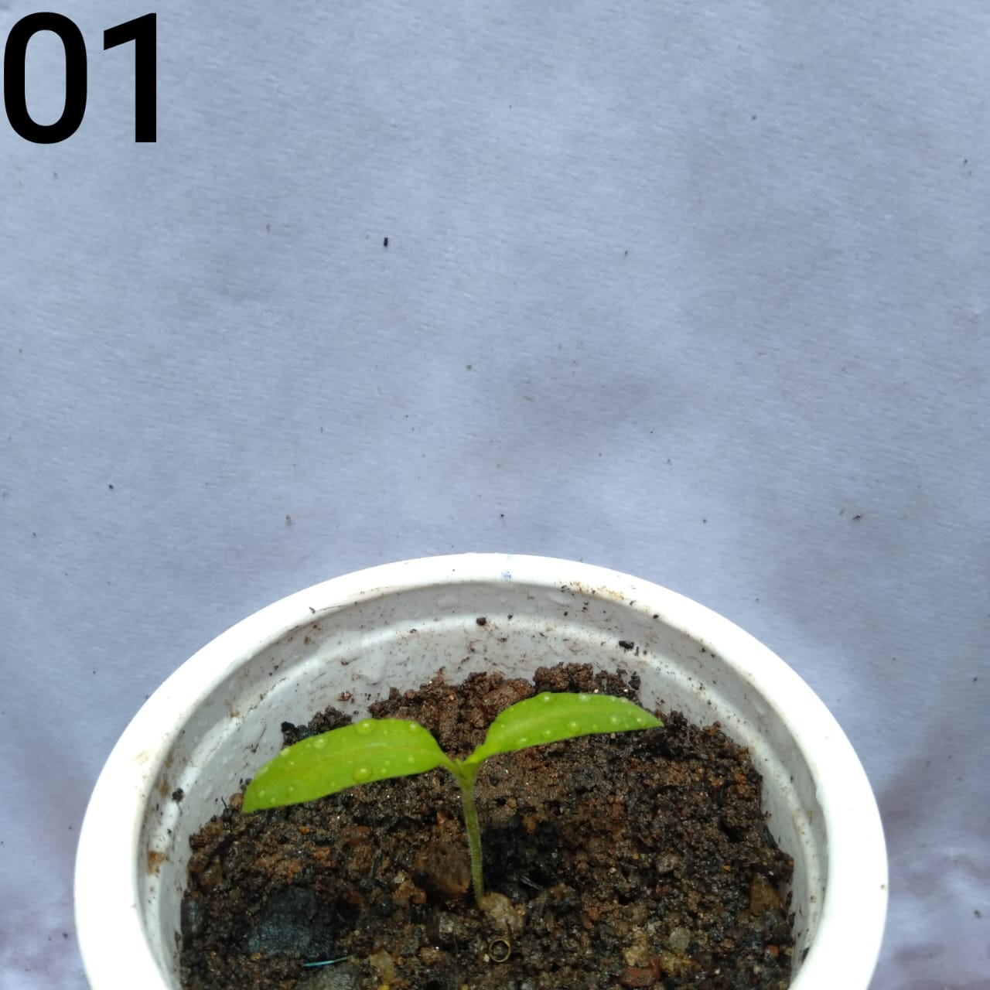
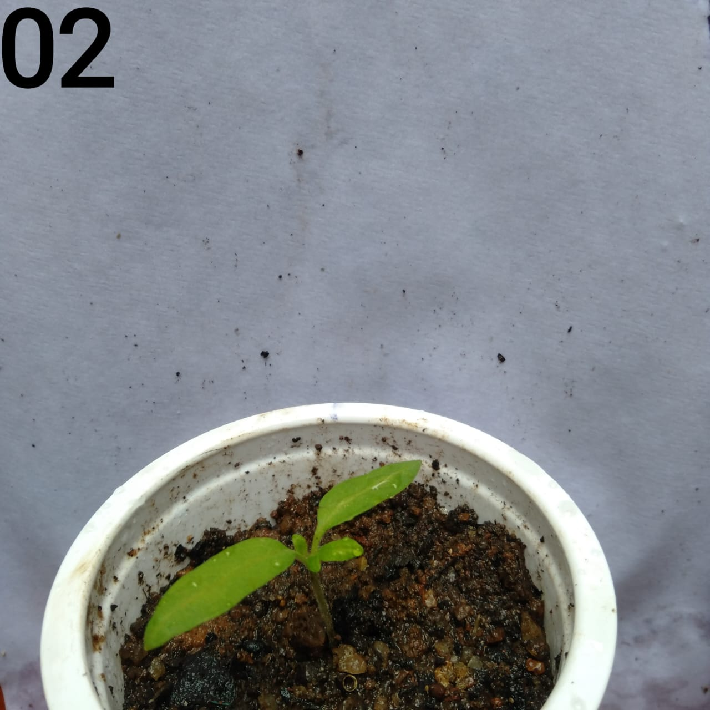
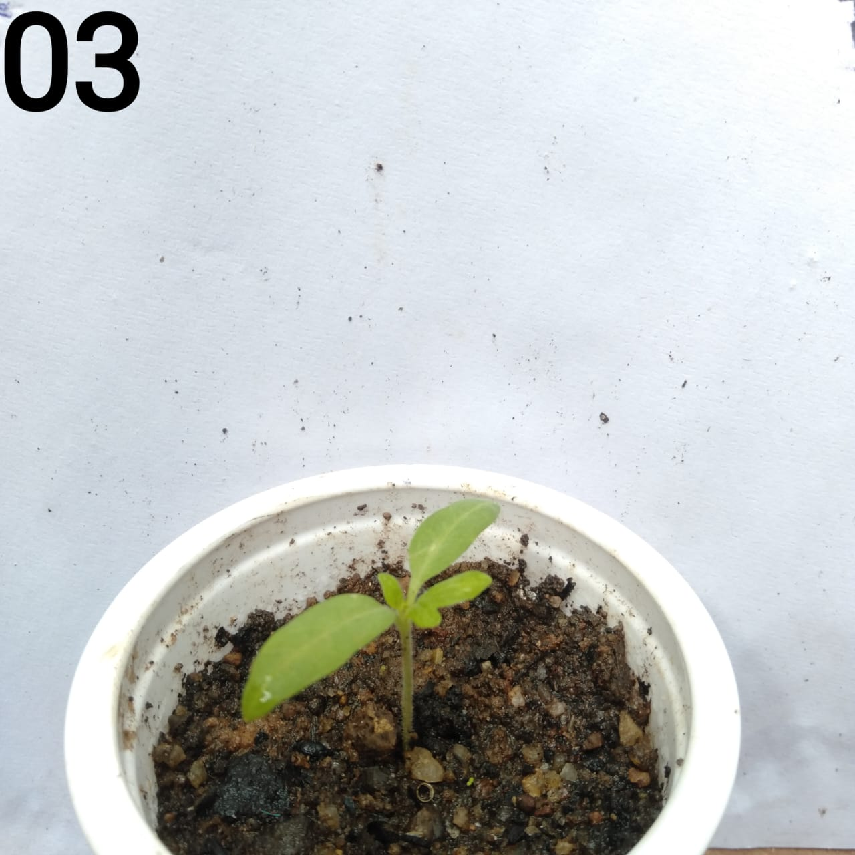
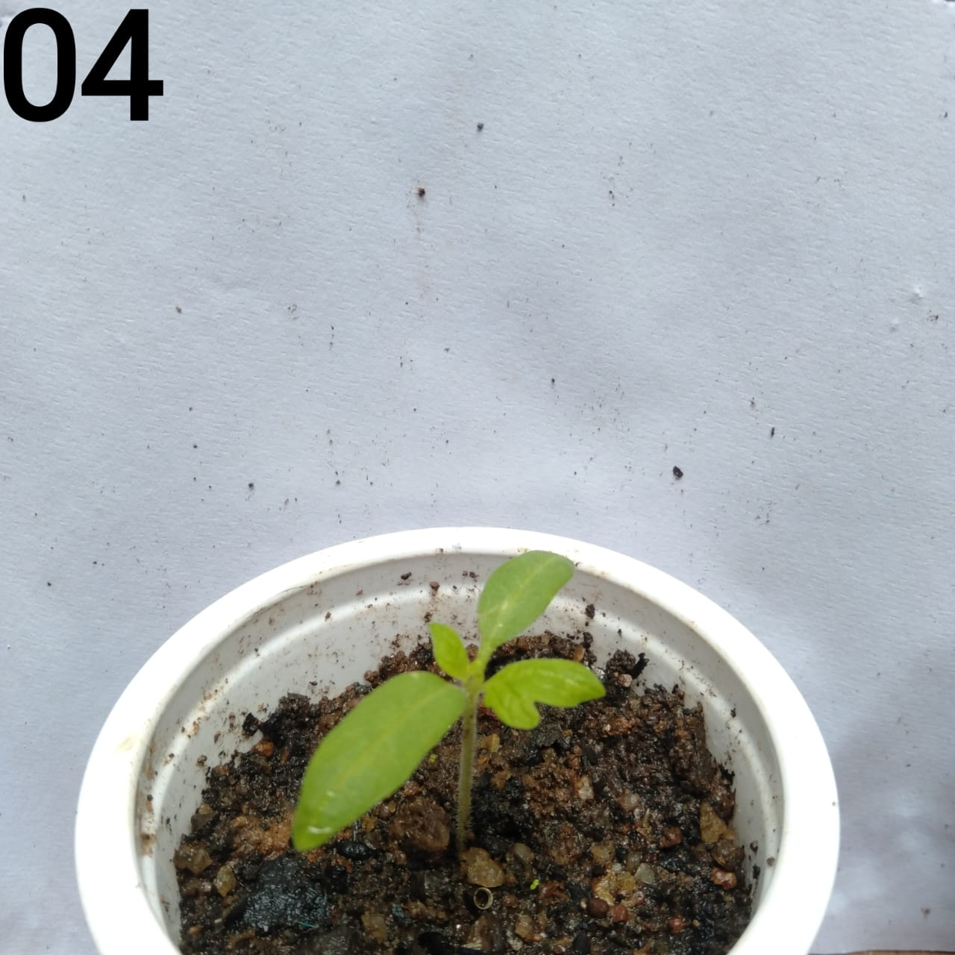
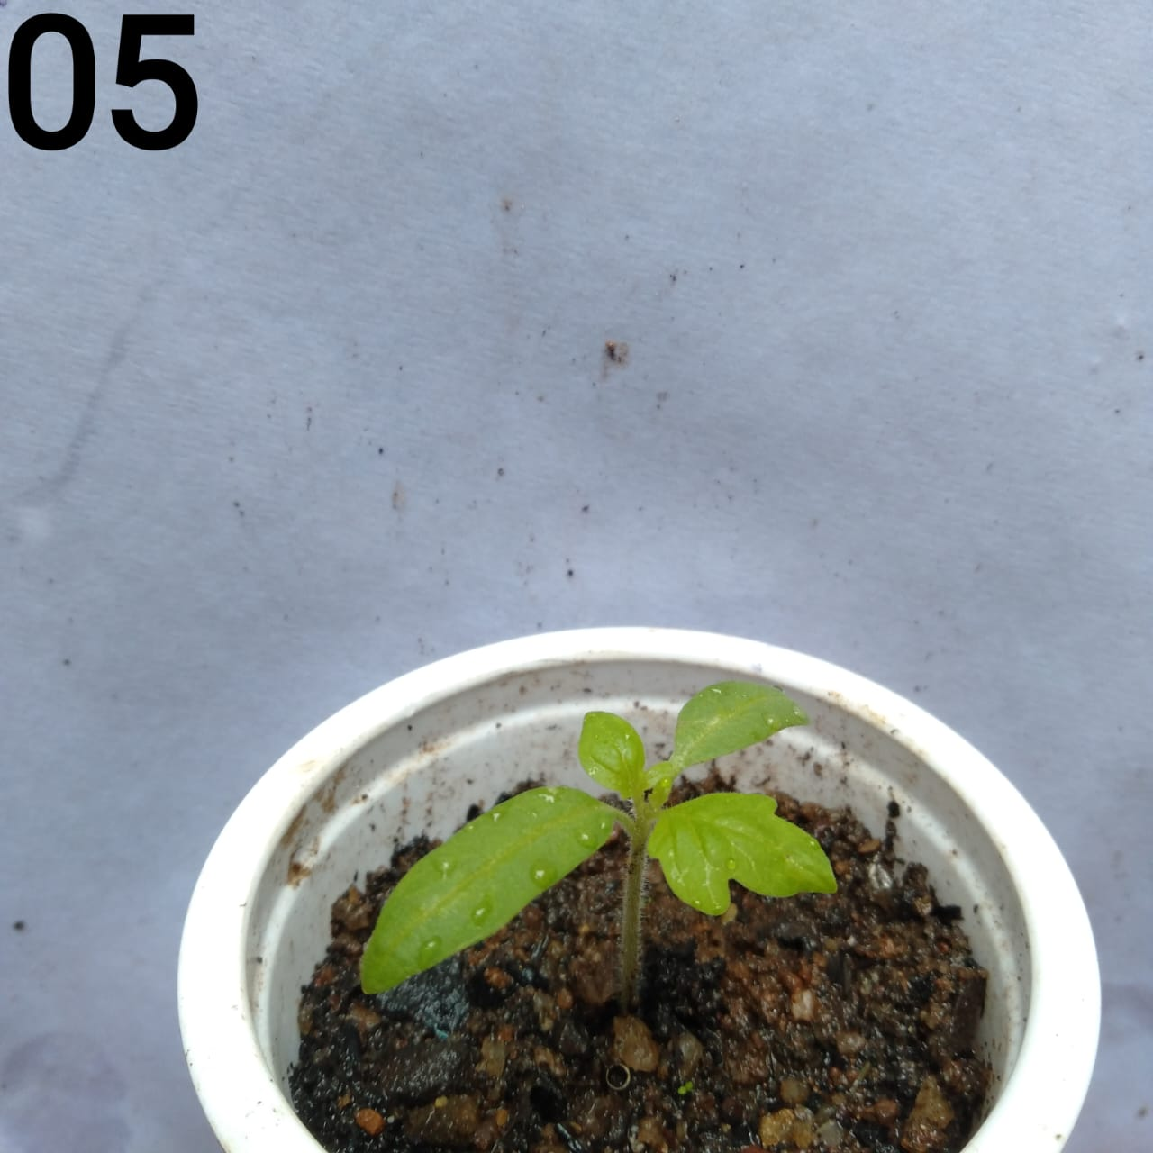
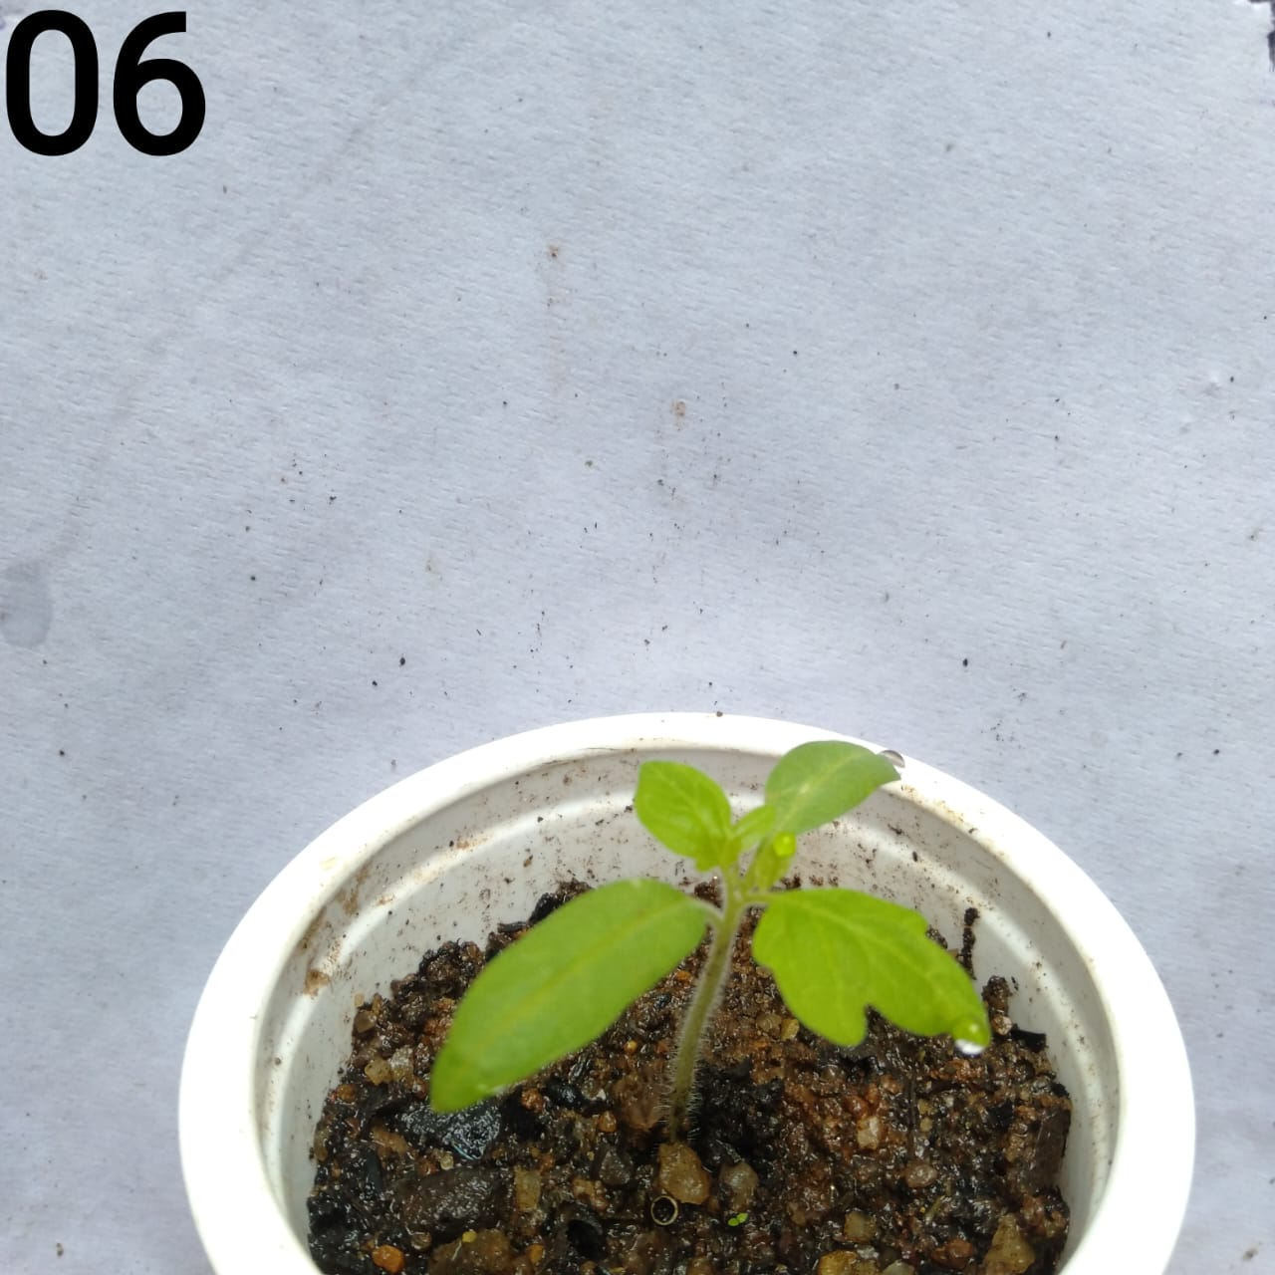
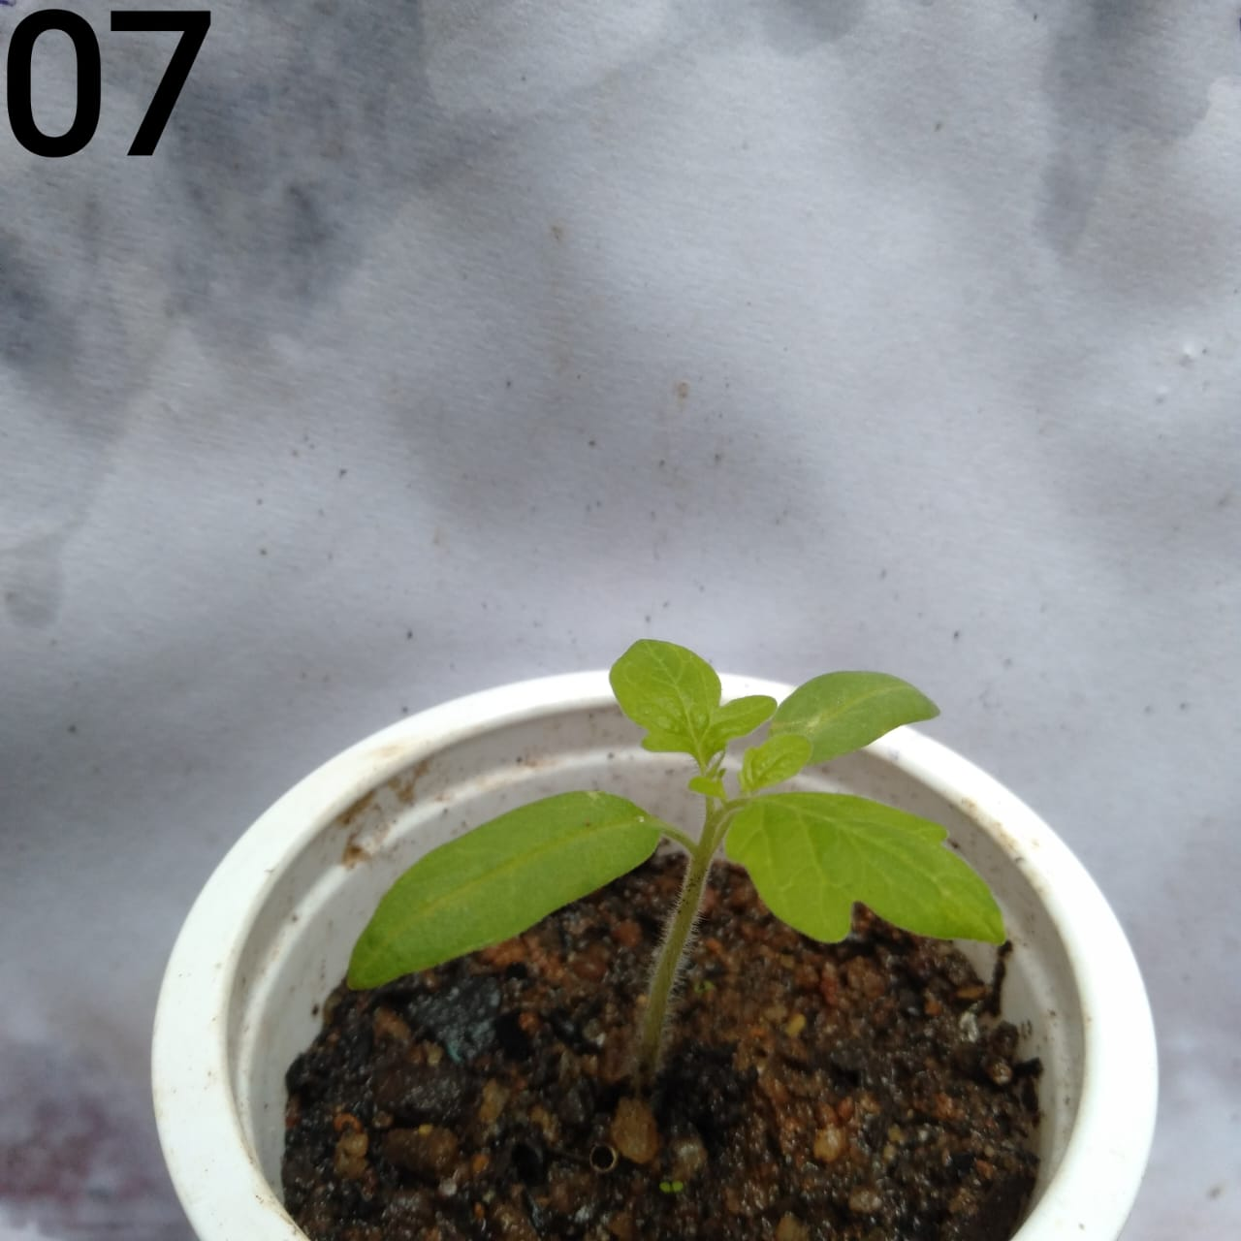
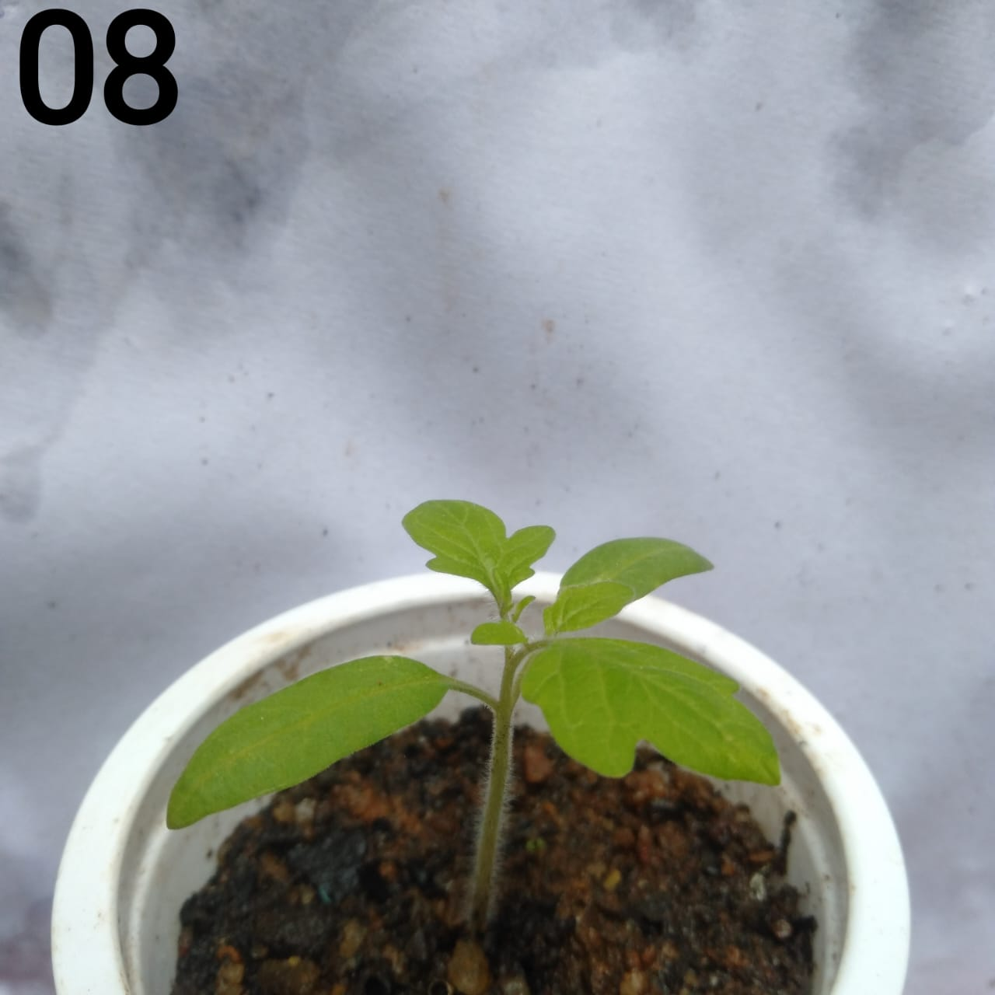
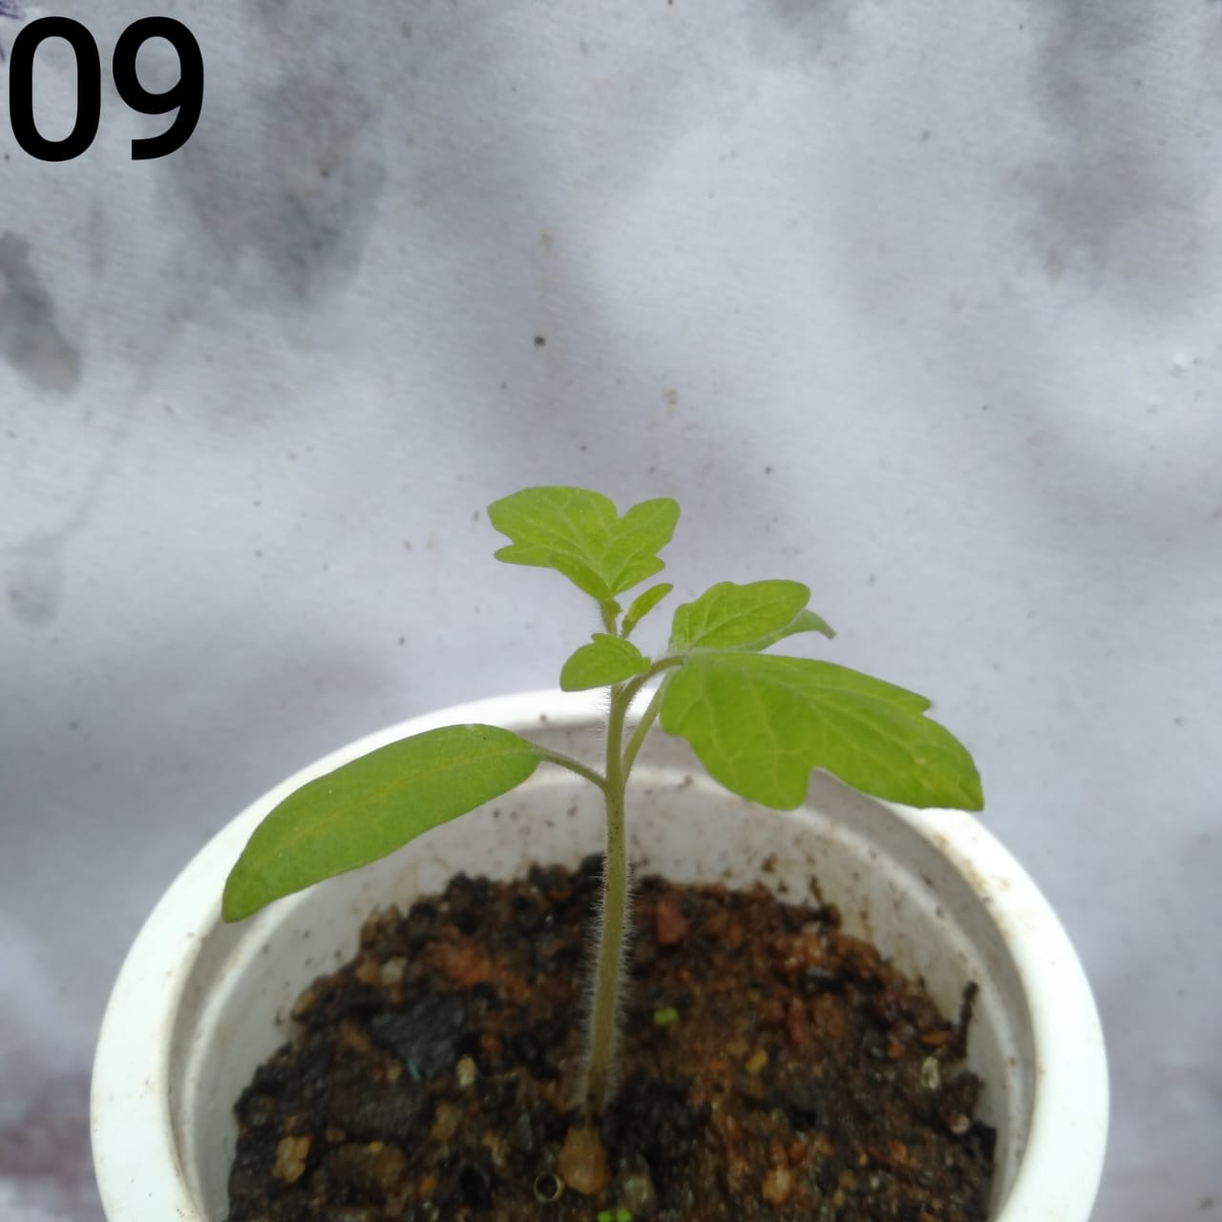
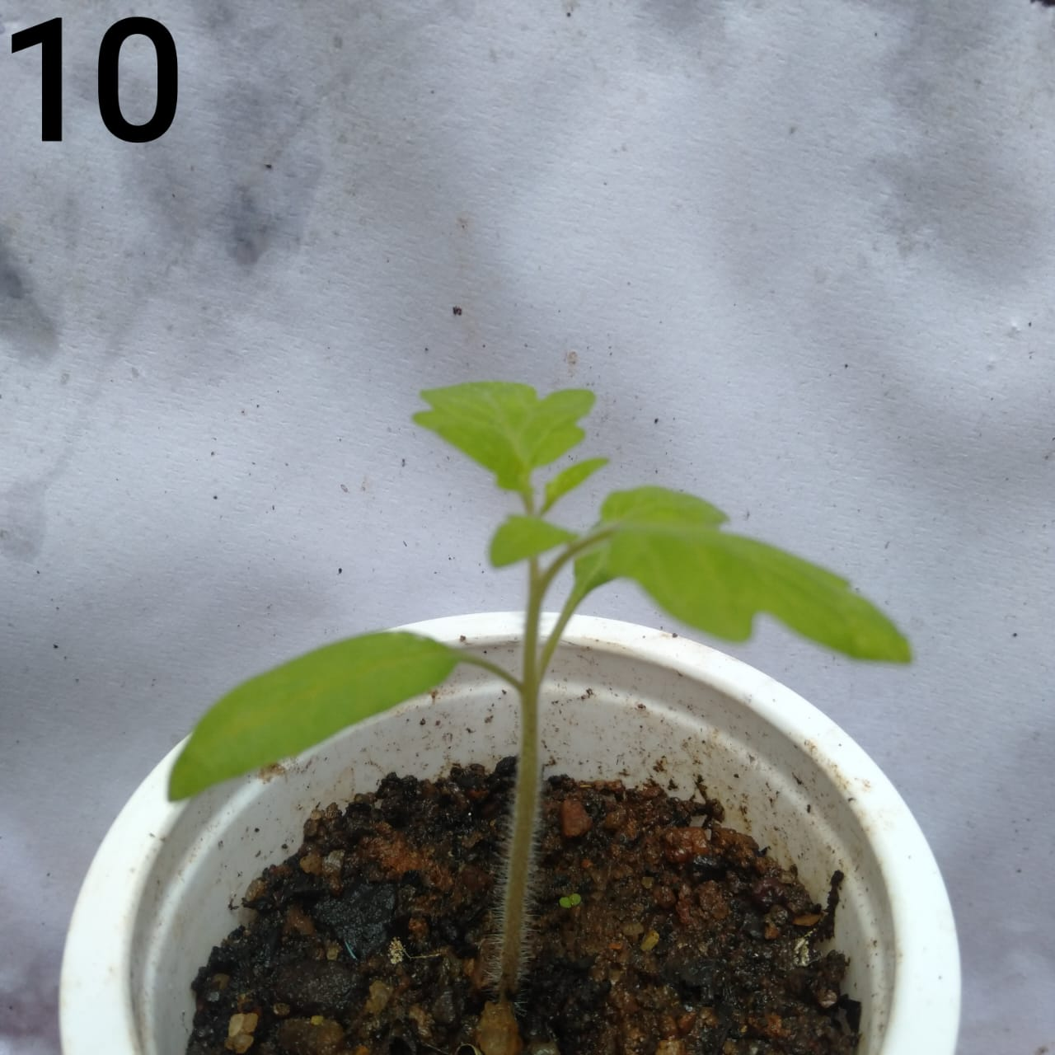
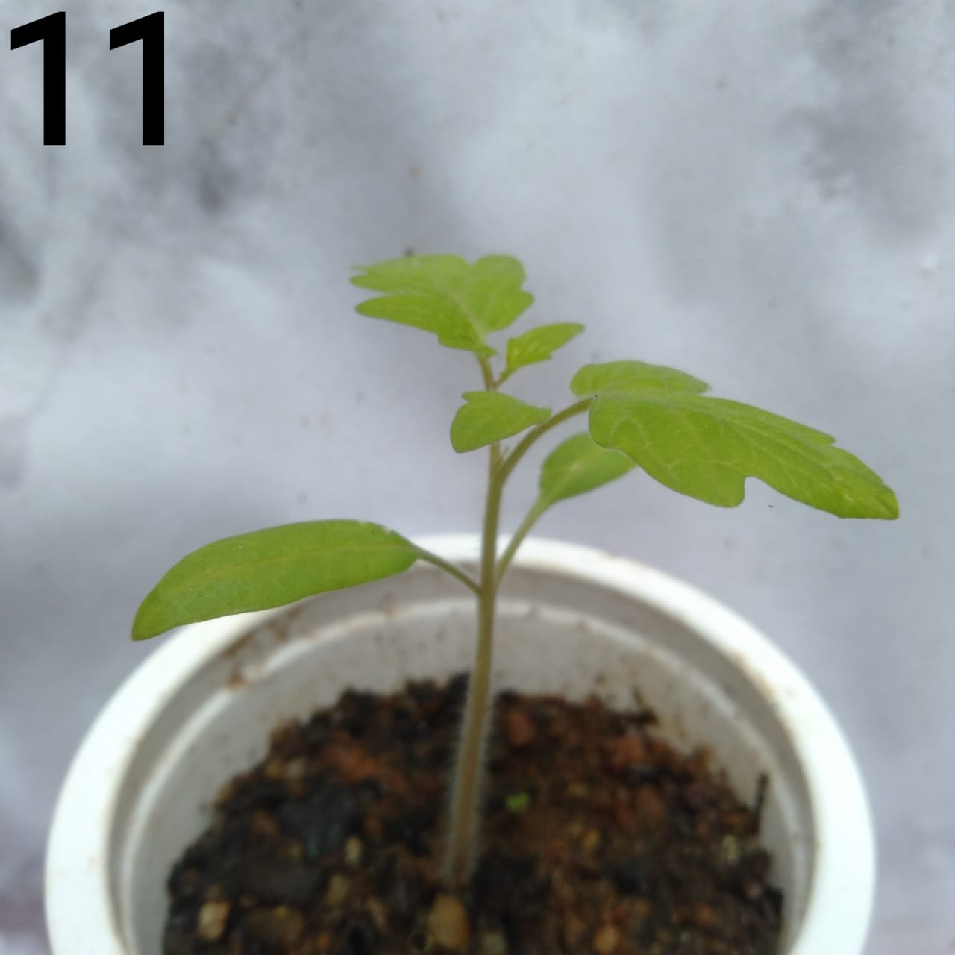
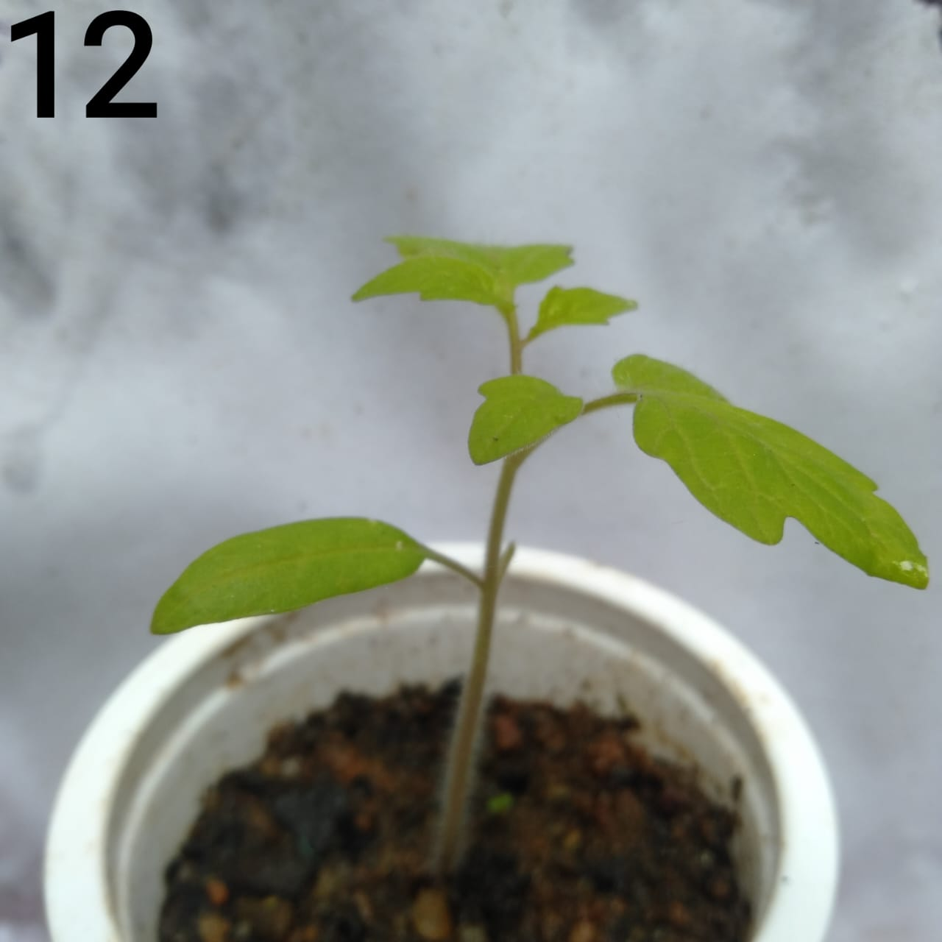
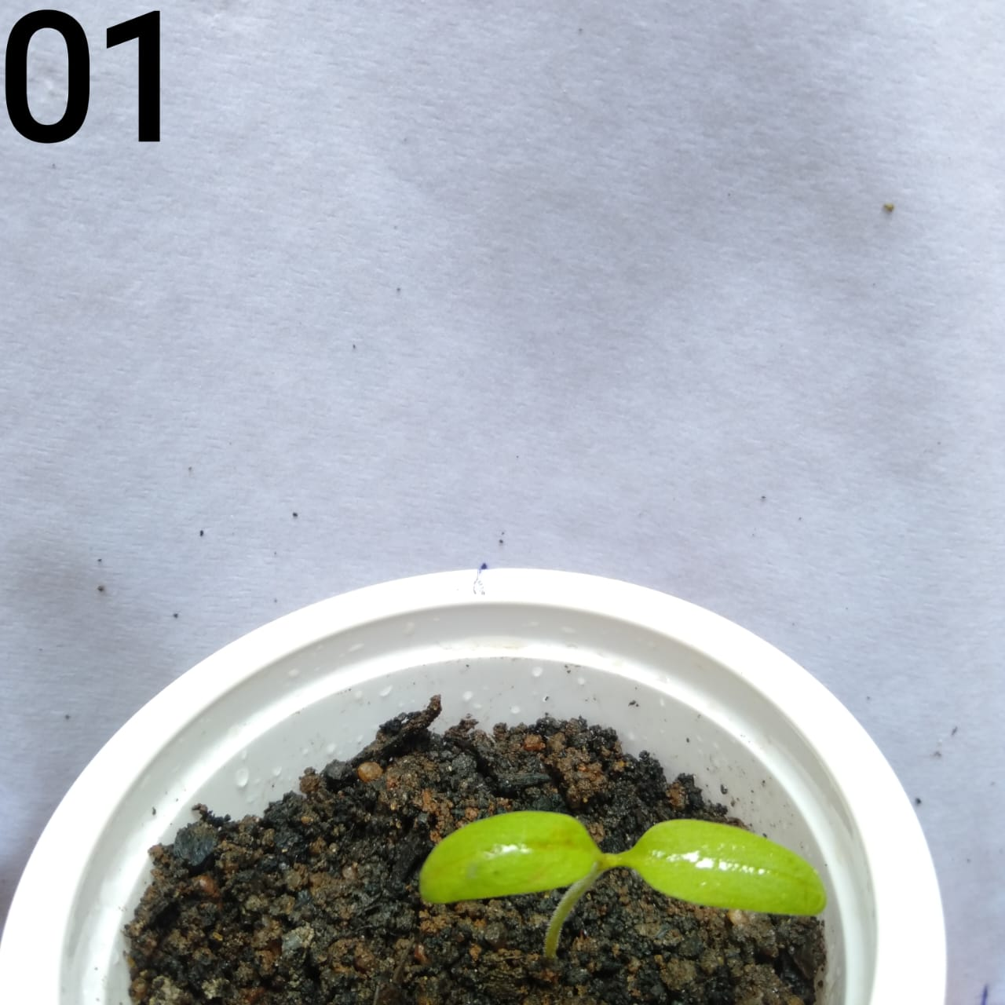
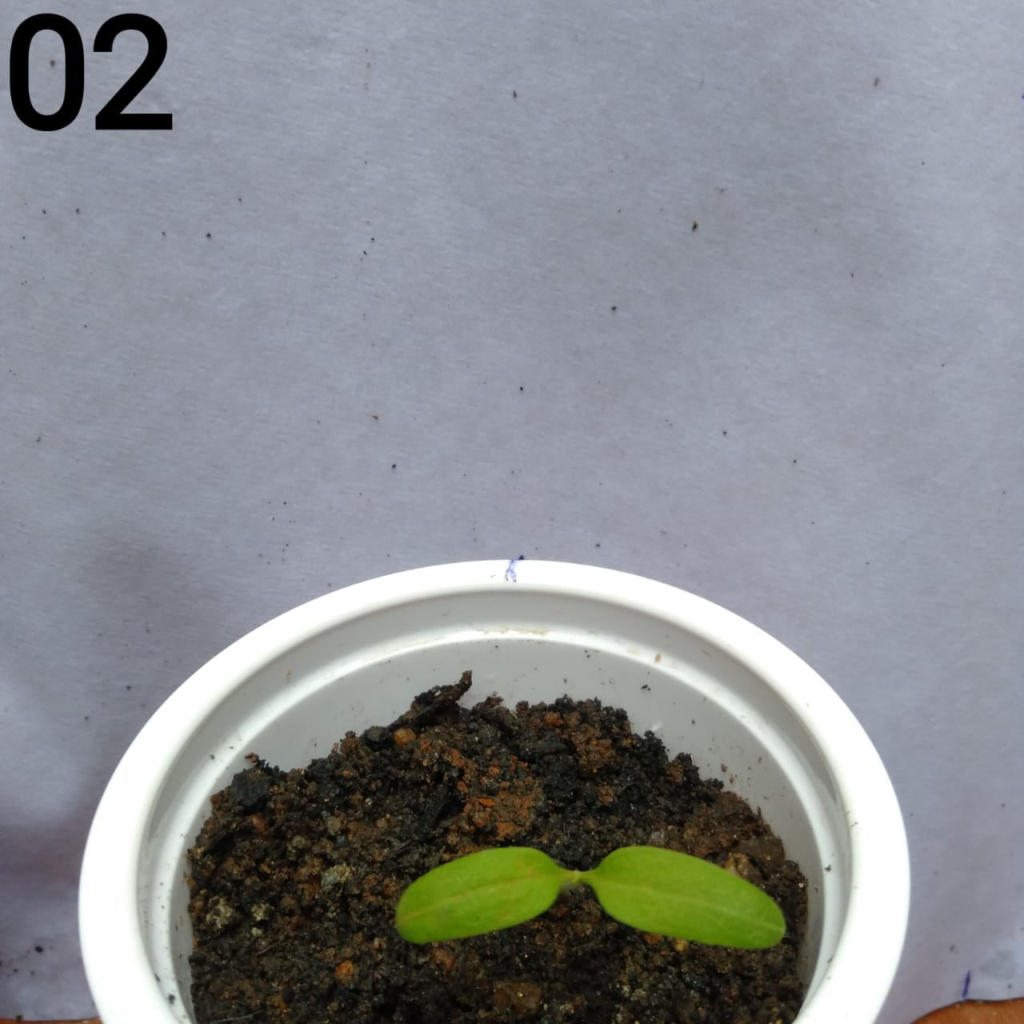
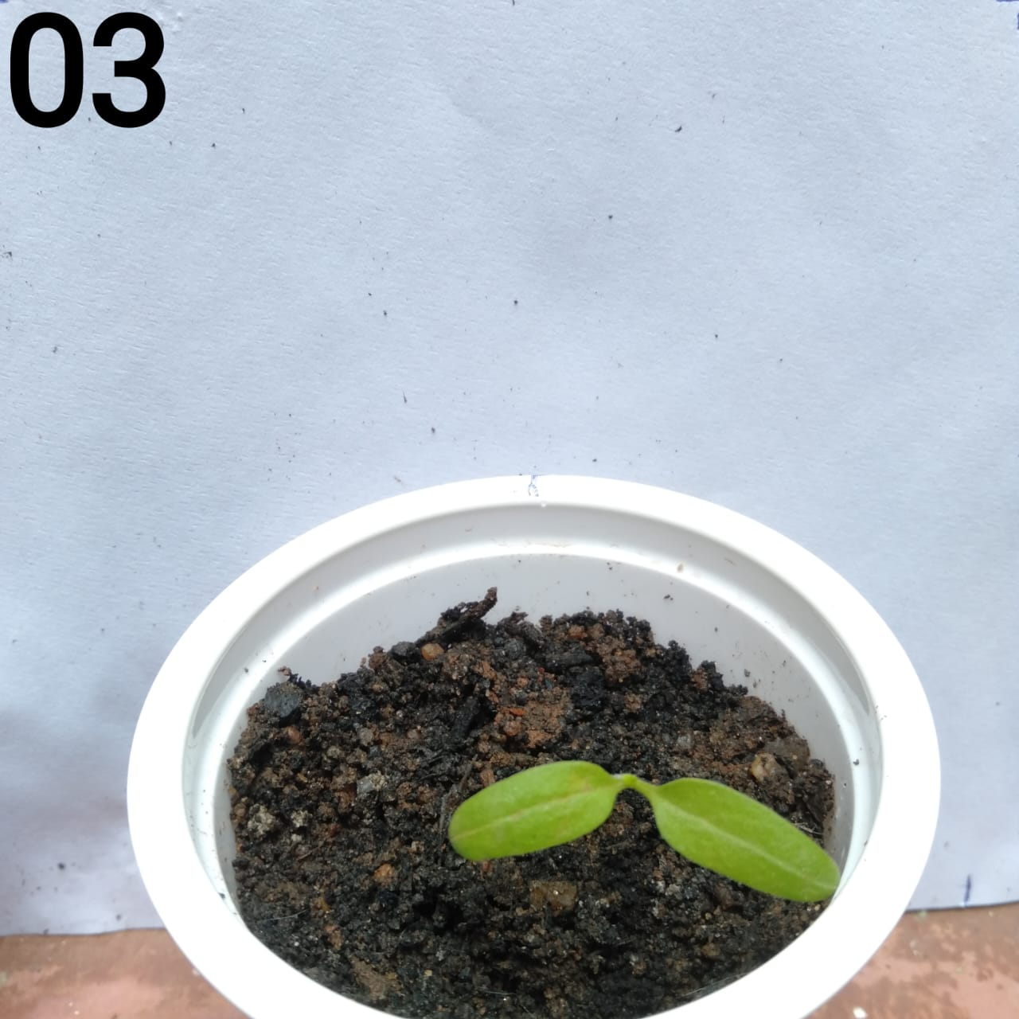
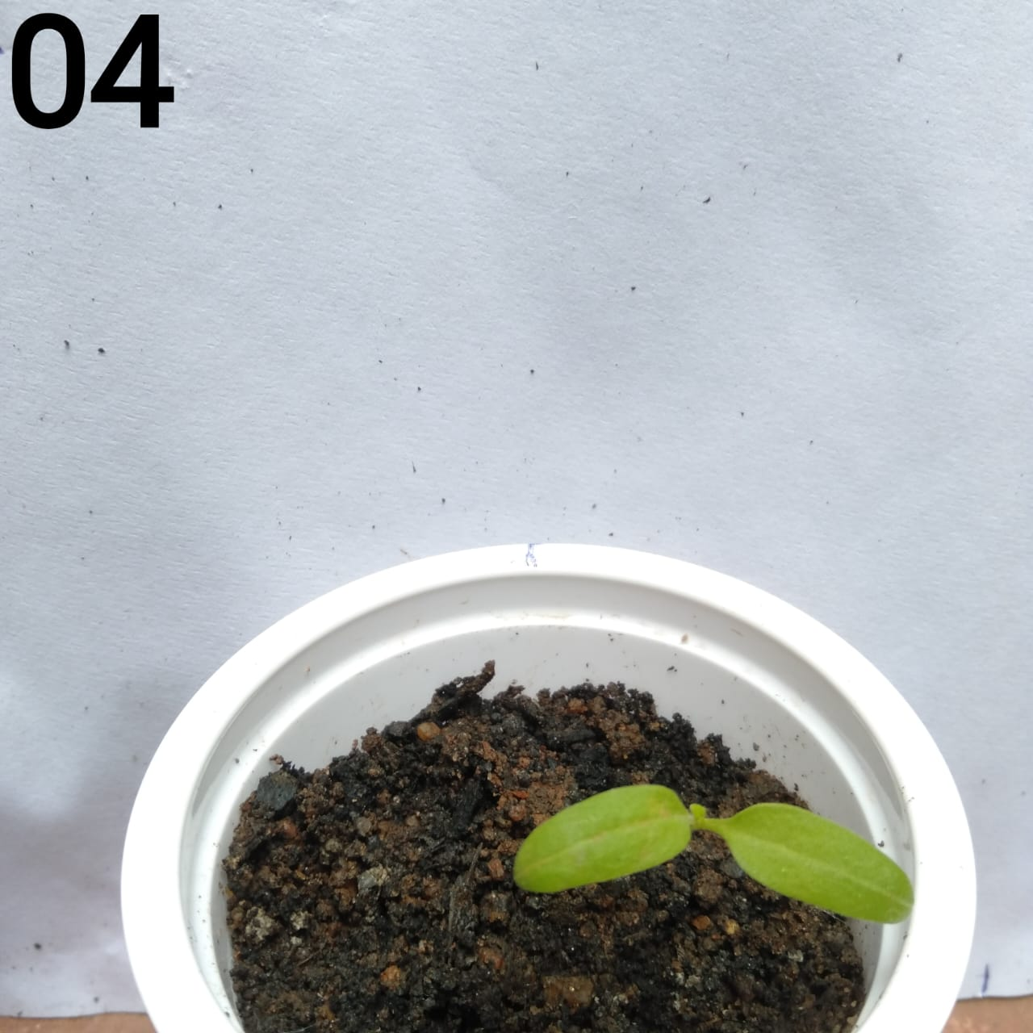
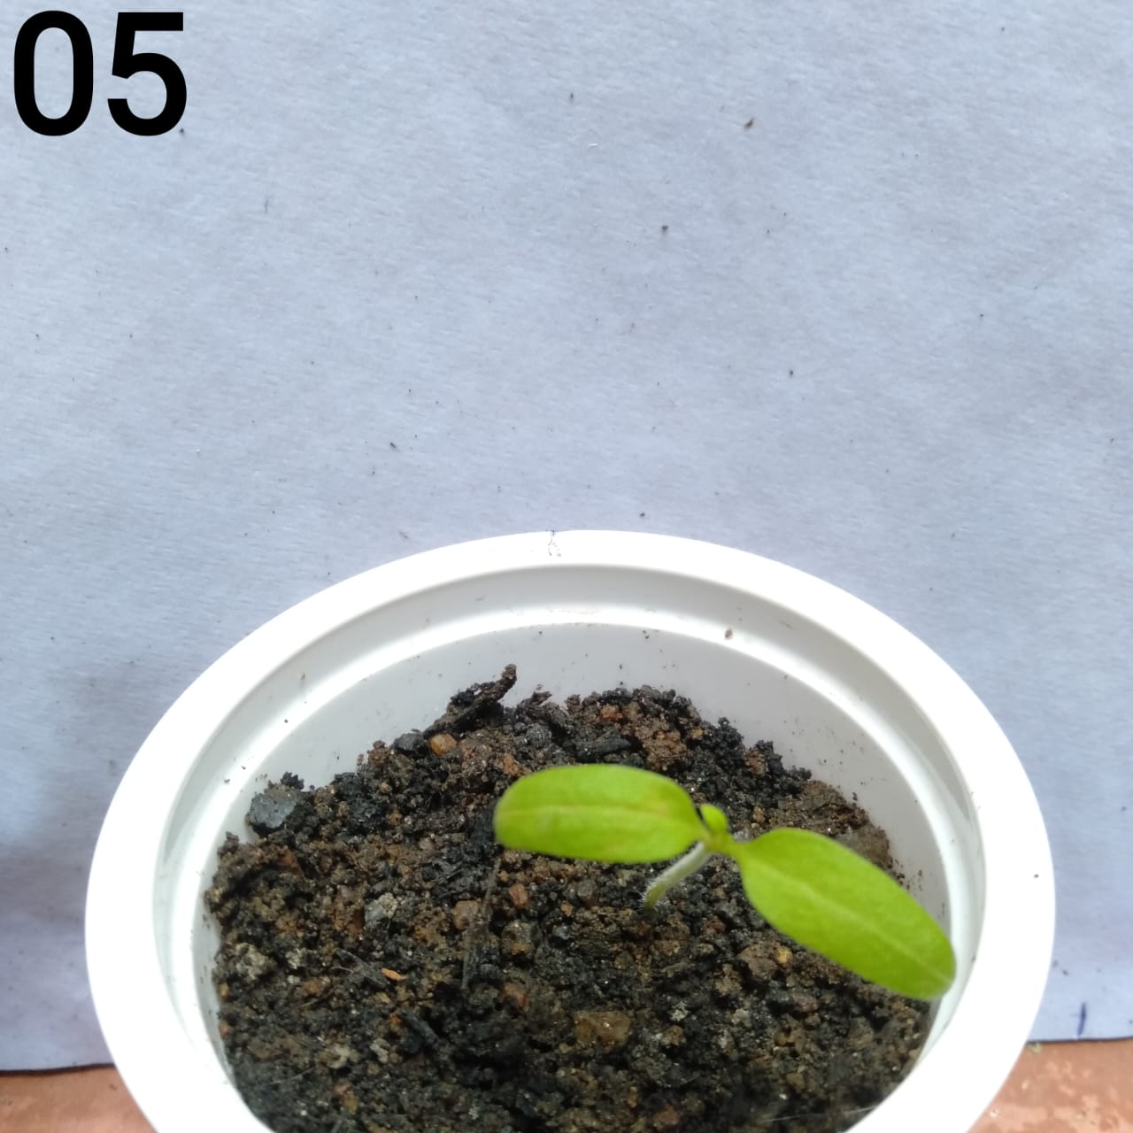
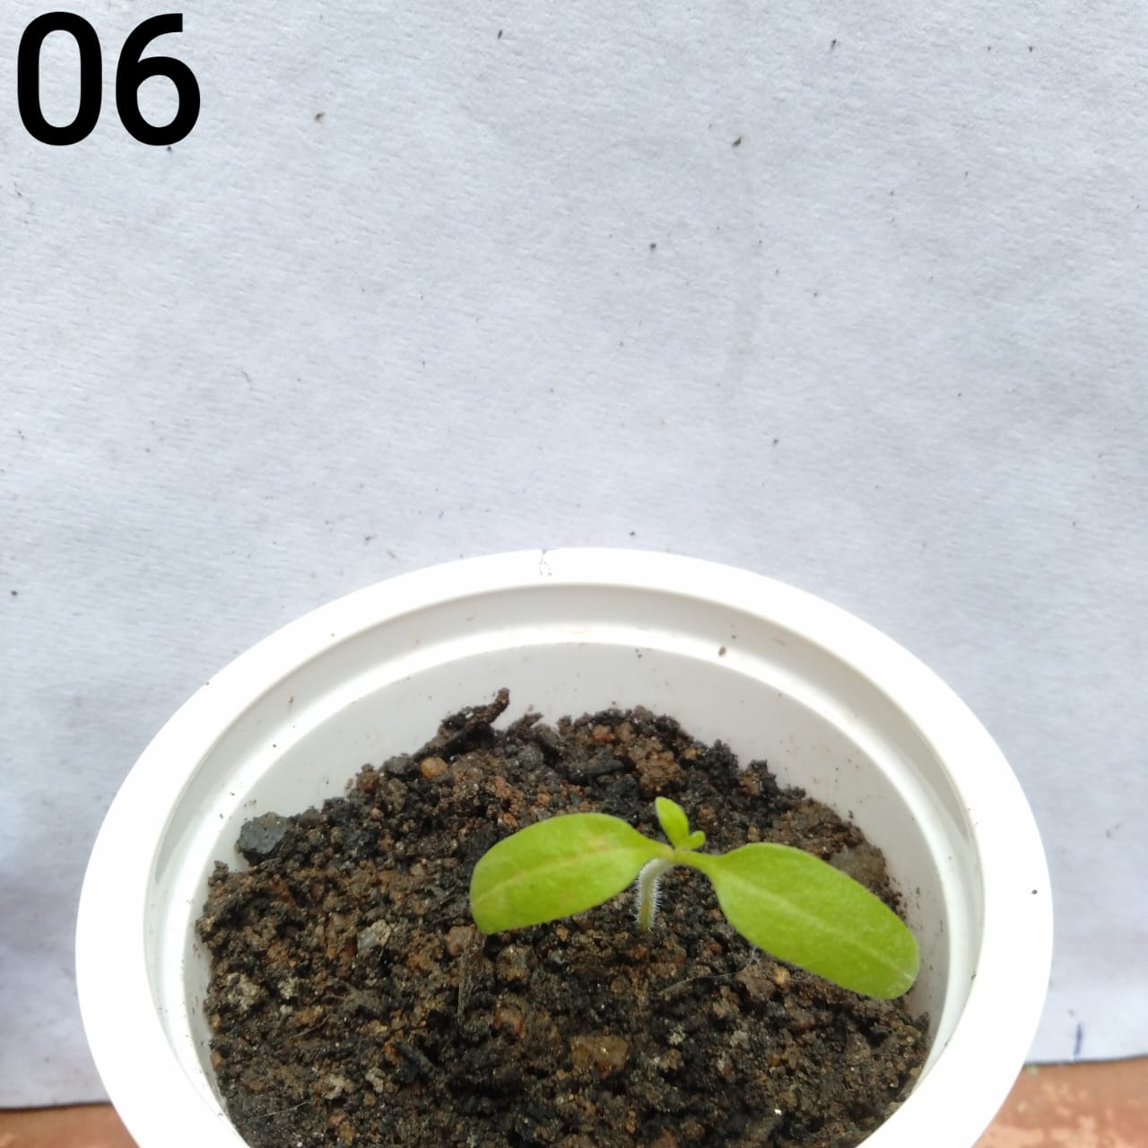
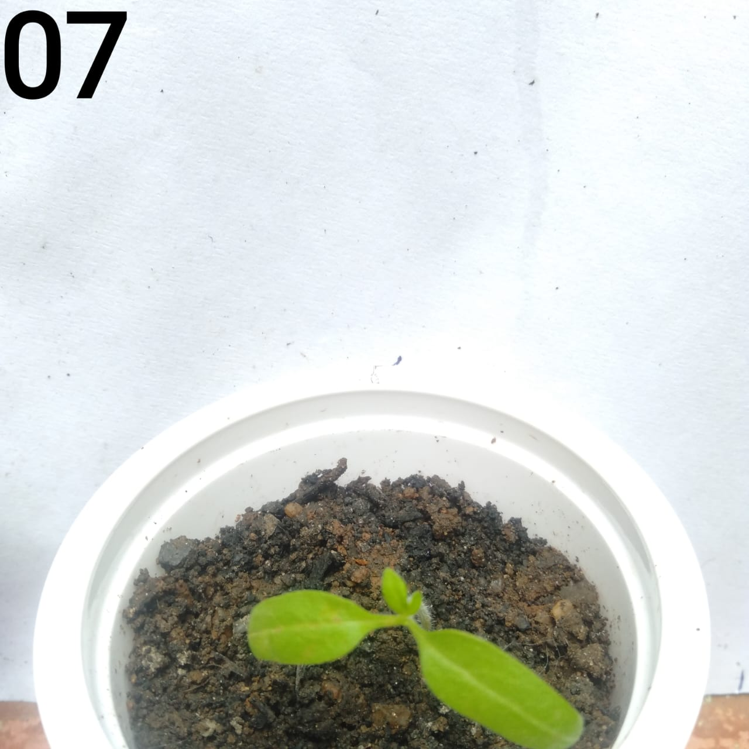
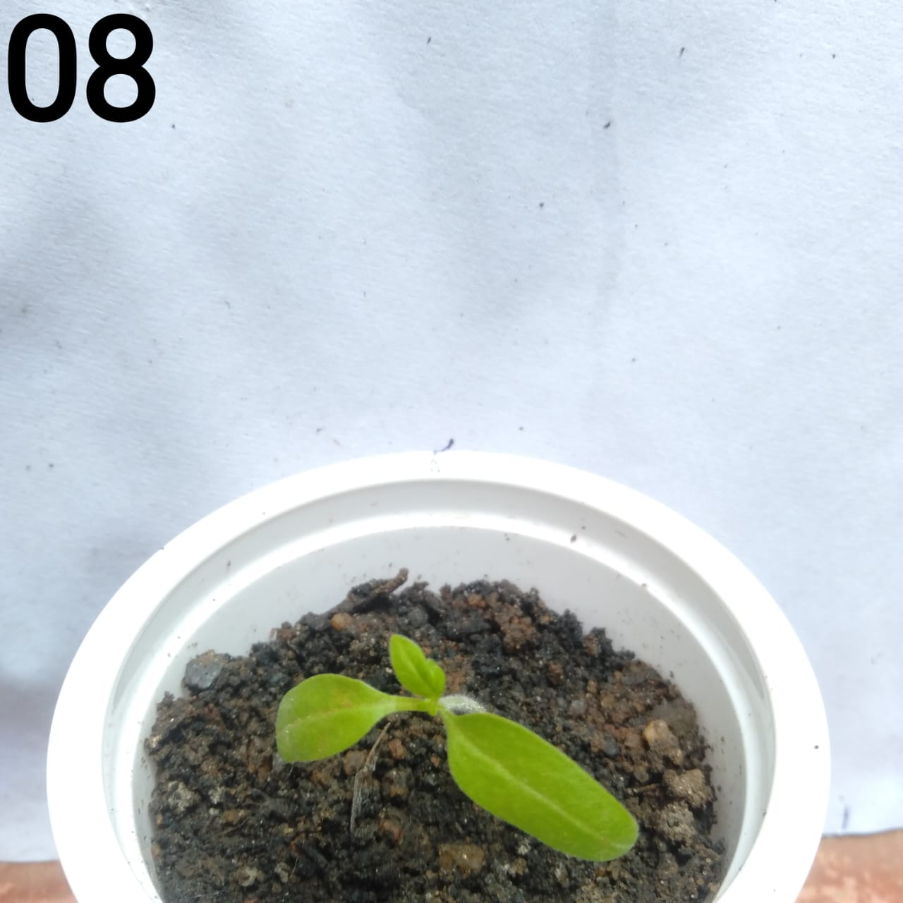
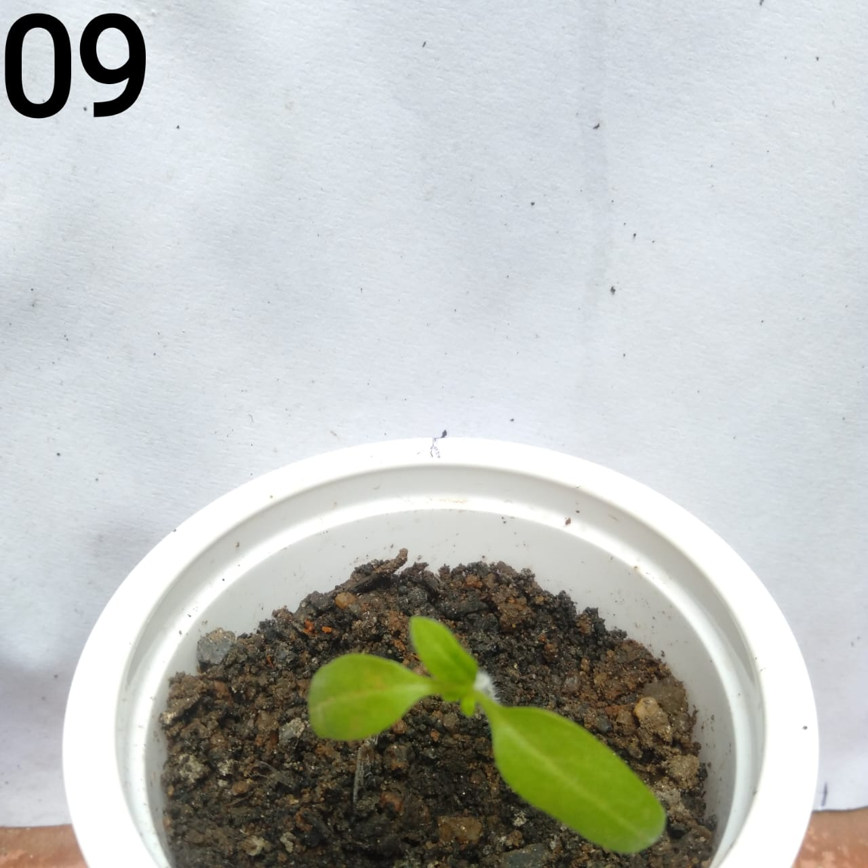
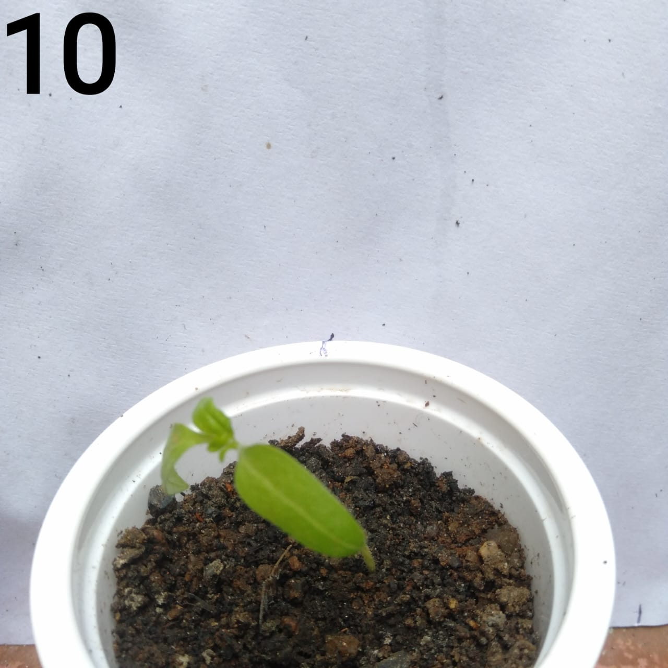
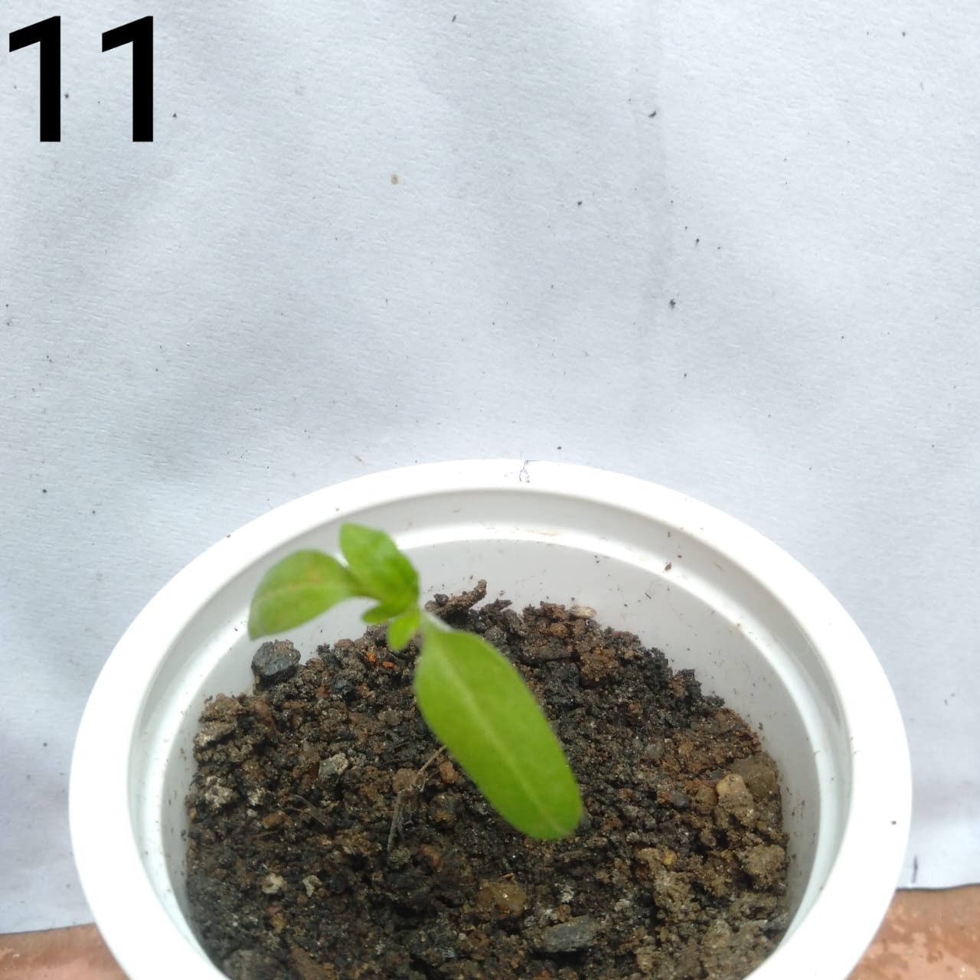
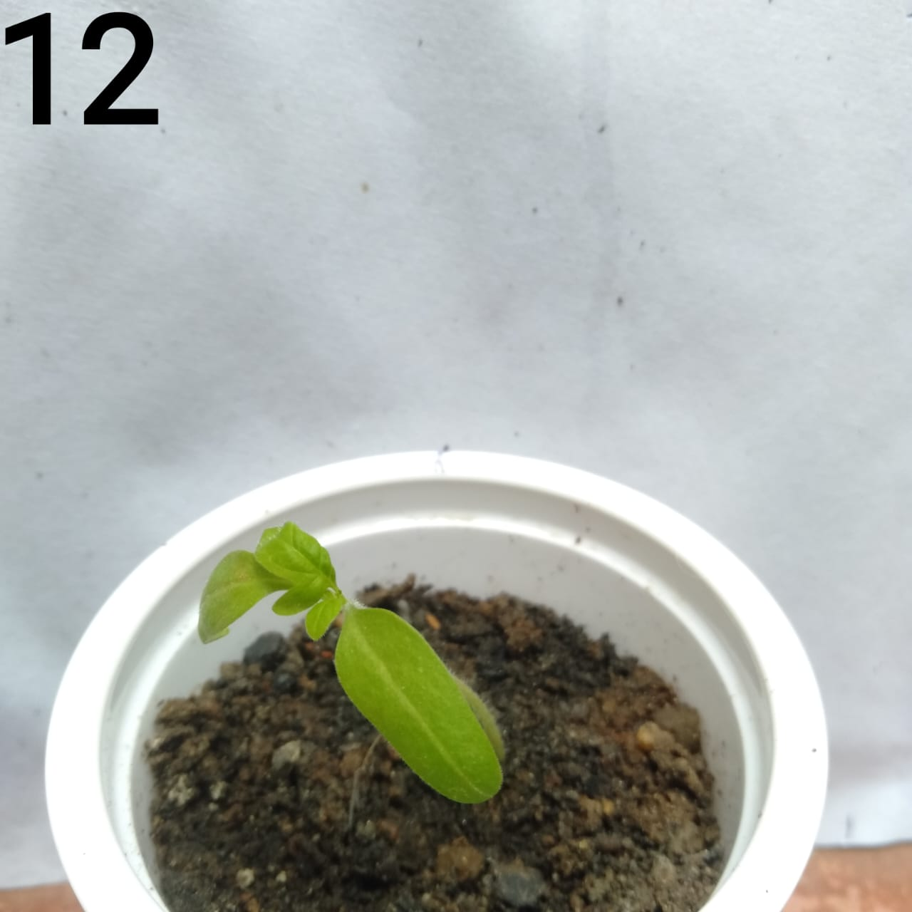
Image Acquisition
No Controls
Water Control

Slide 5
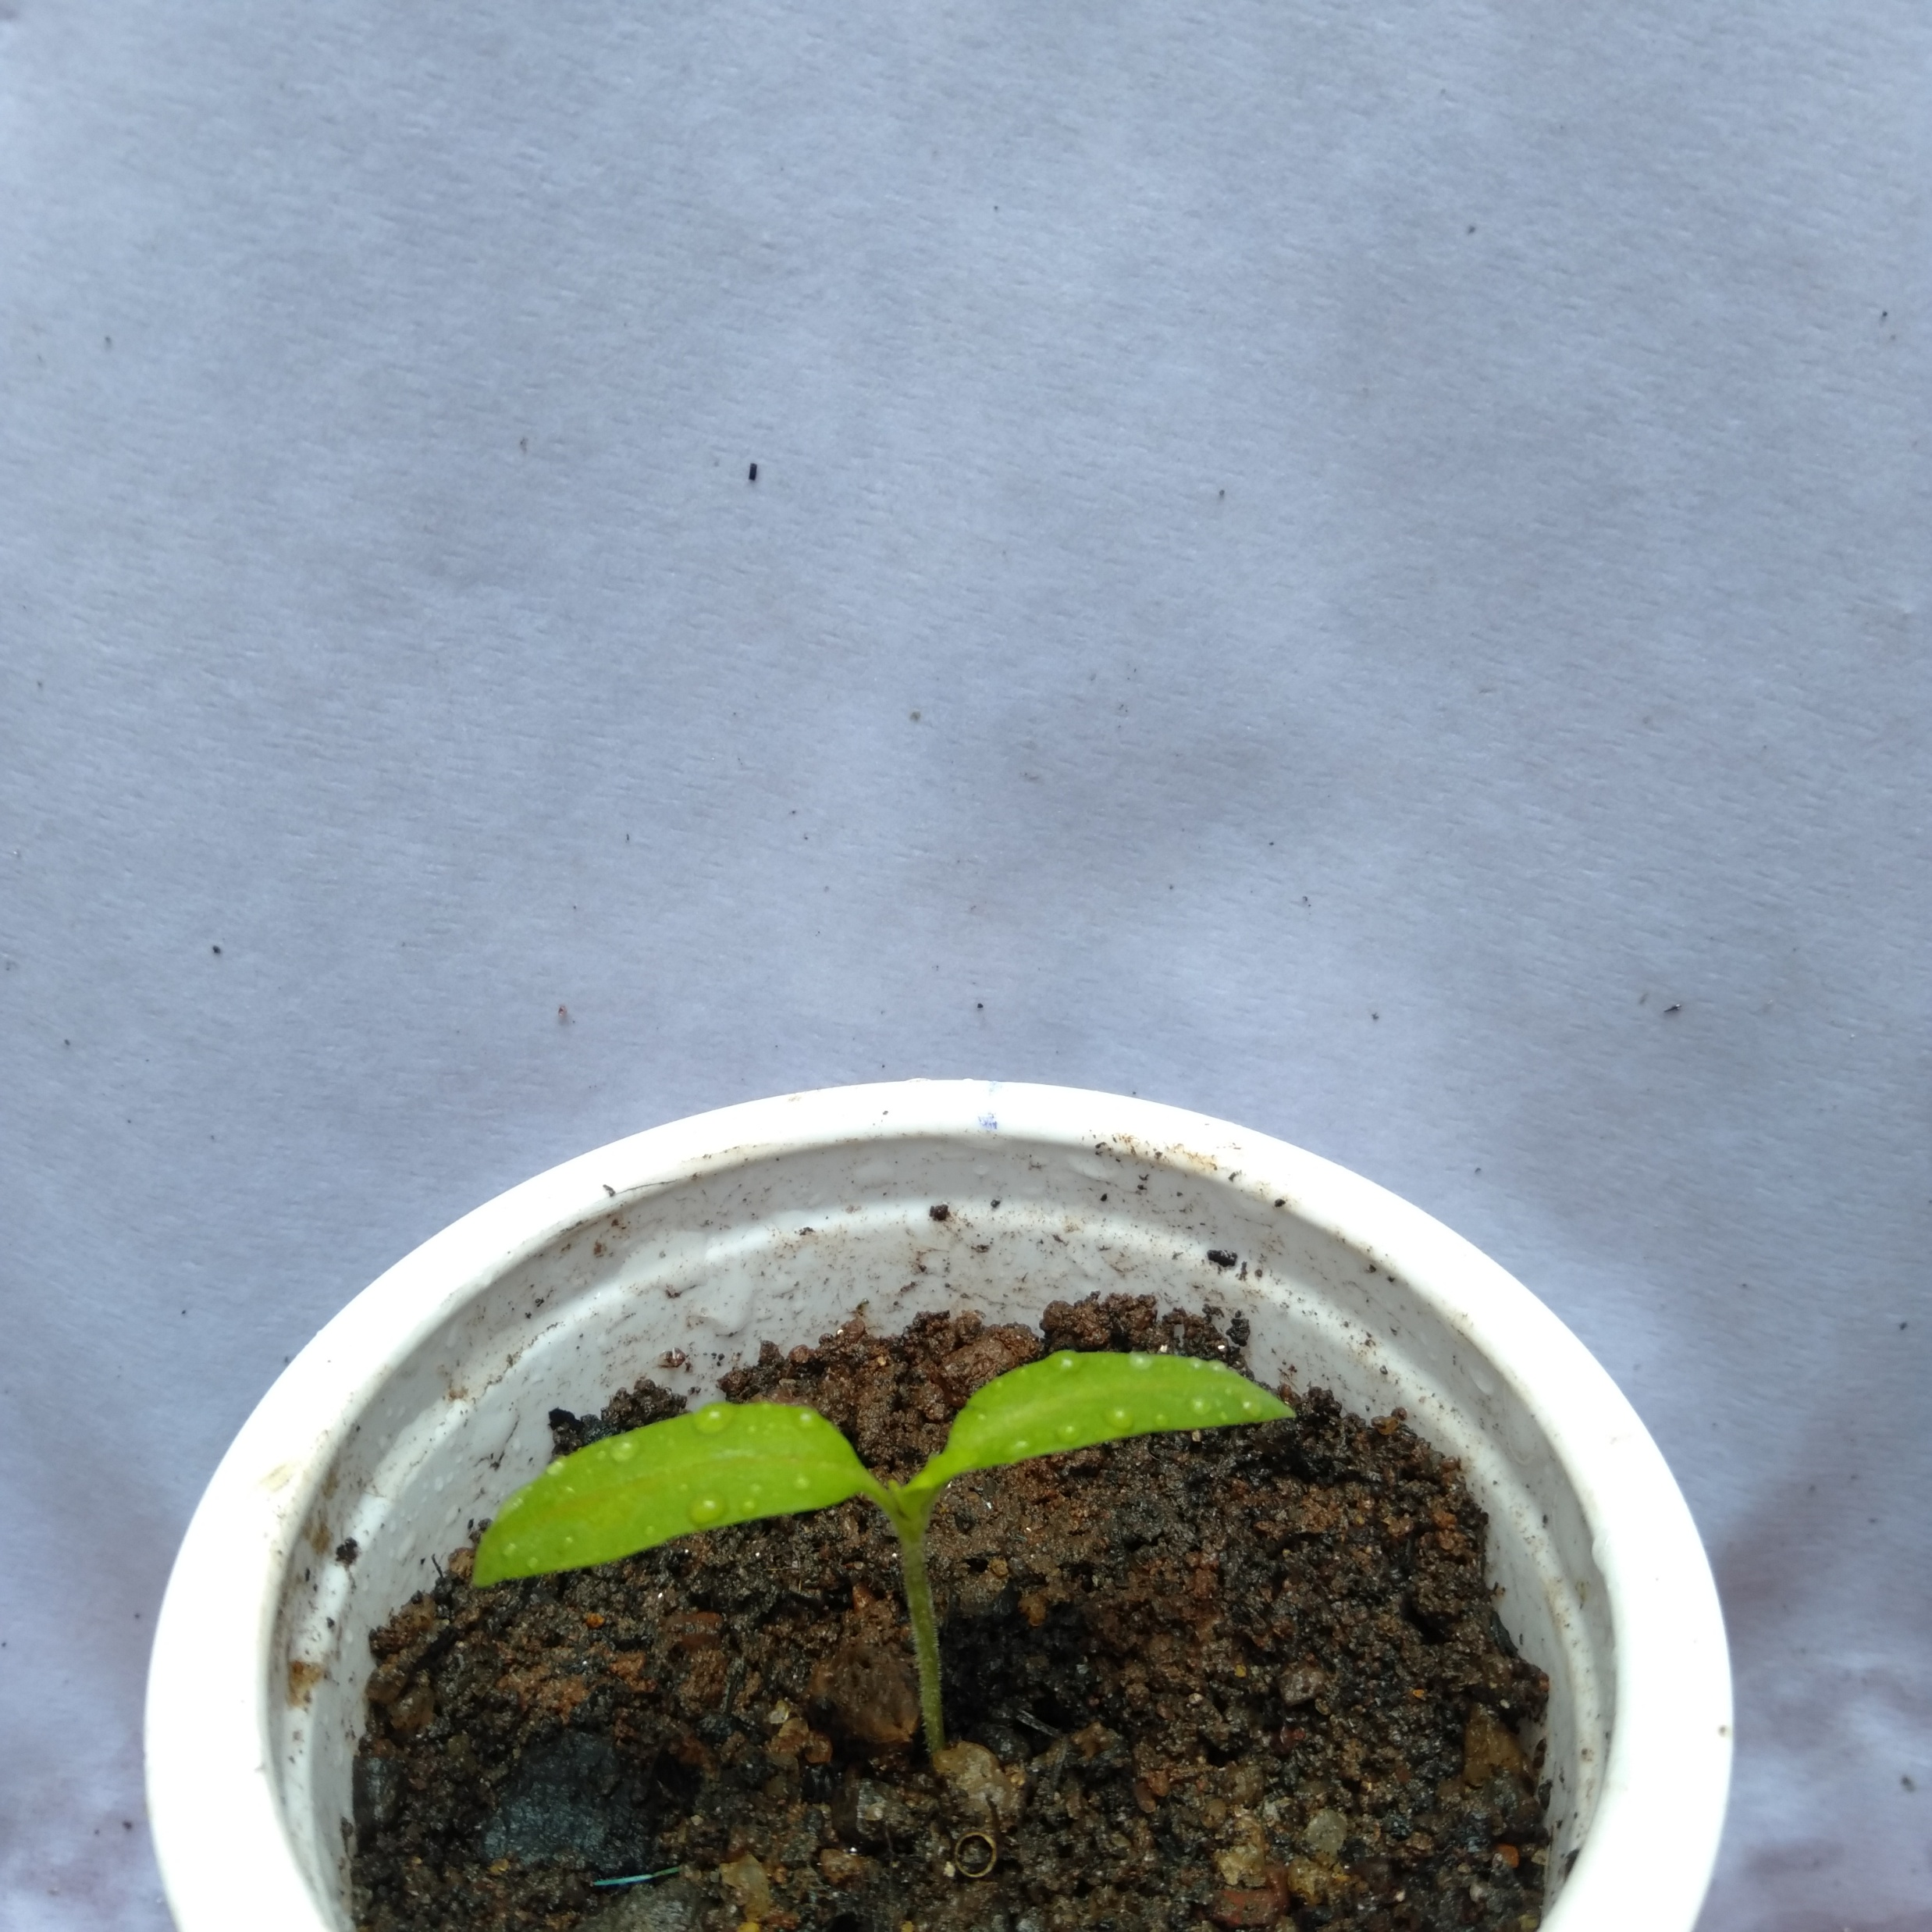
Day 1 - Original Image

Slide 6

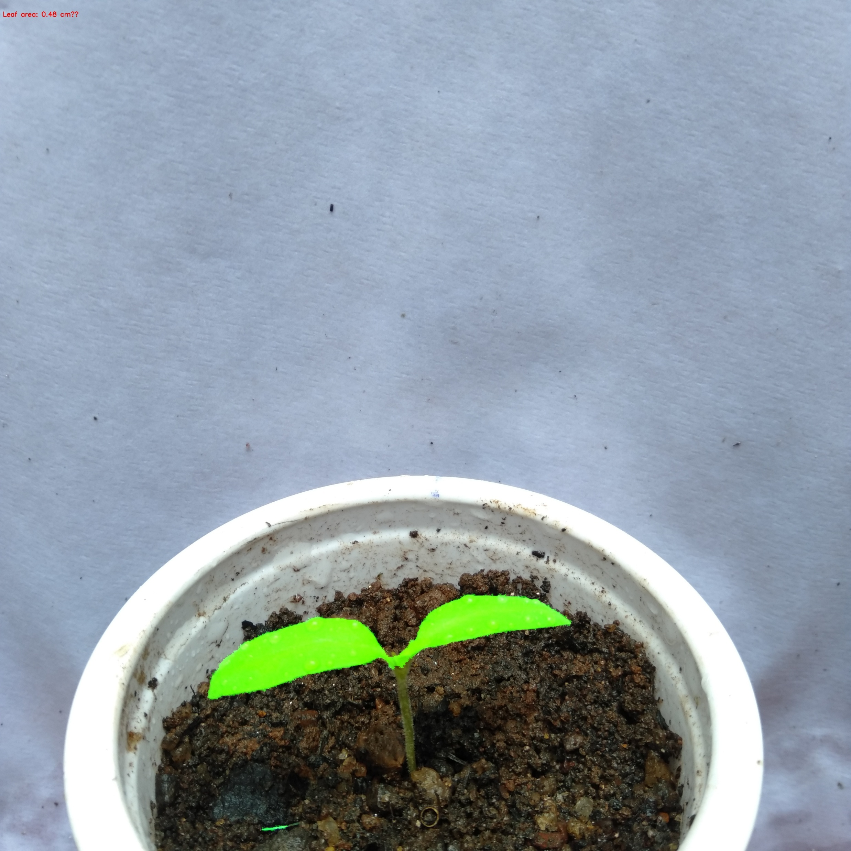
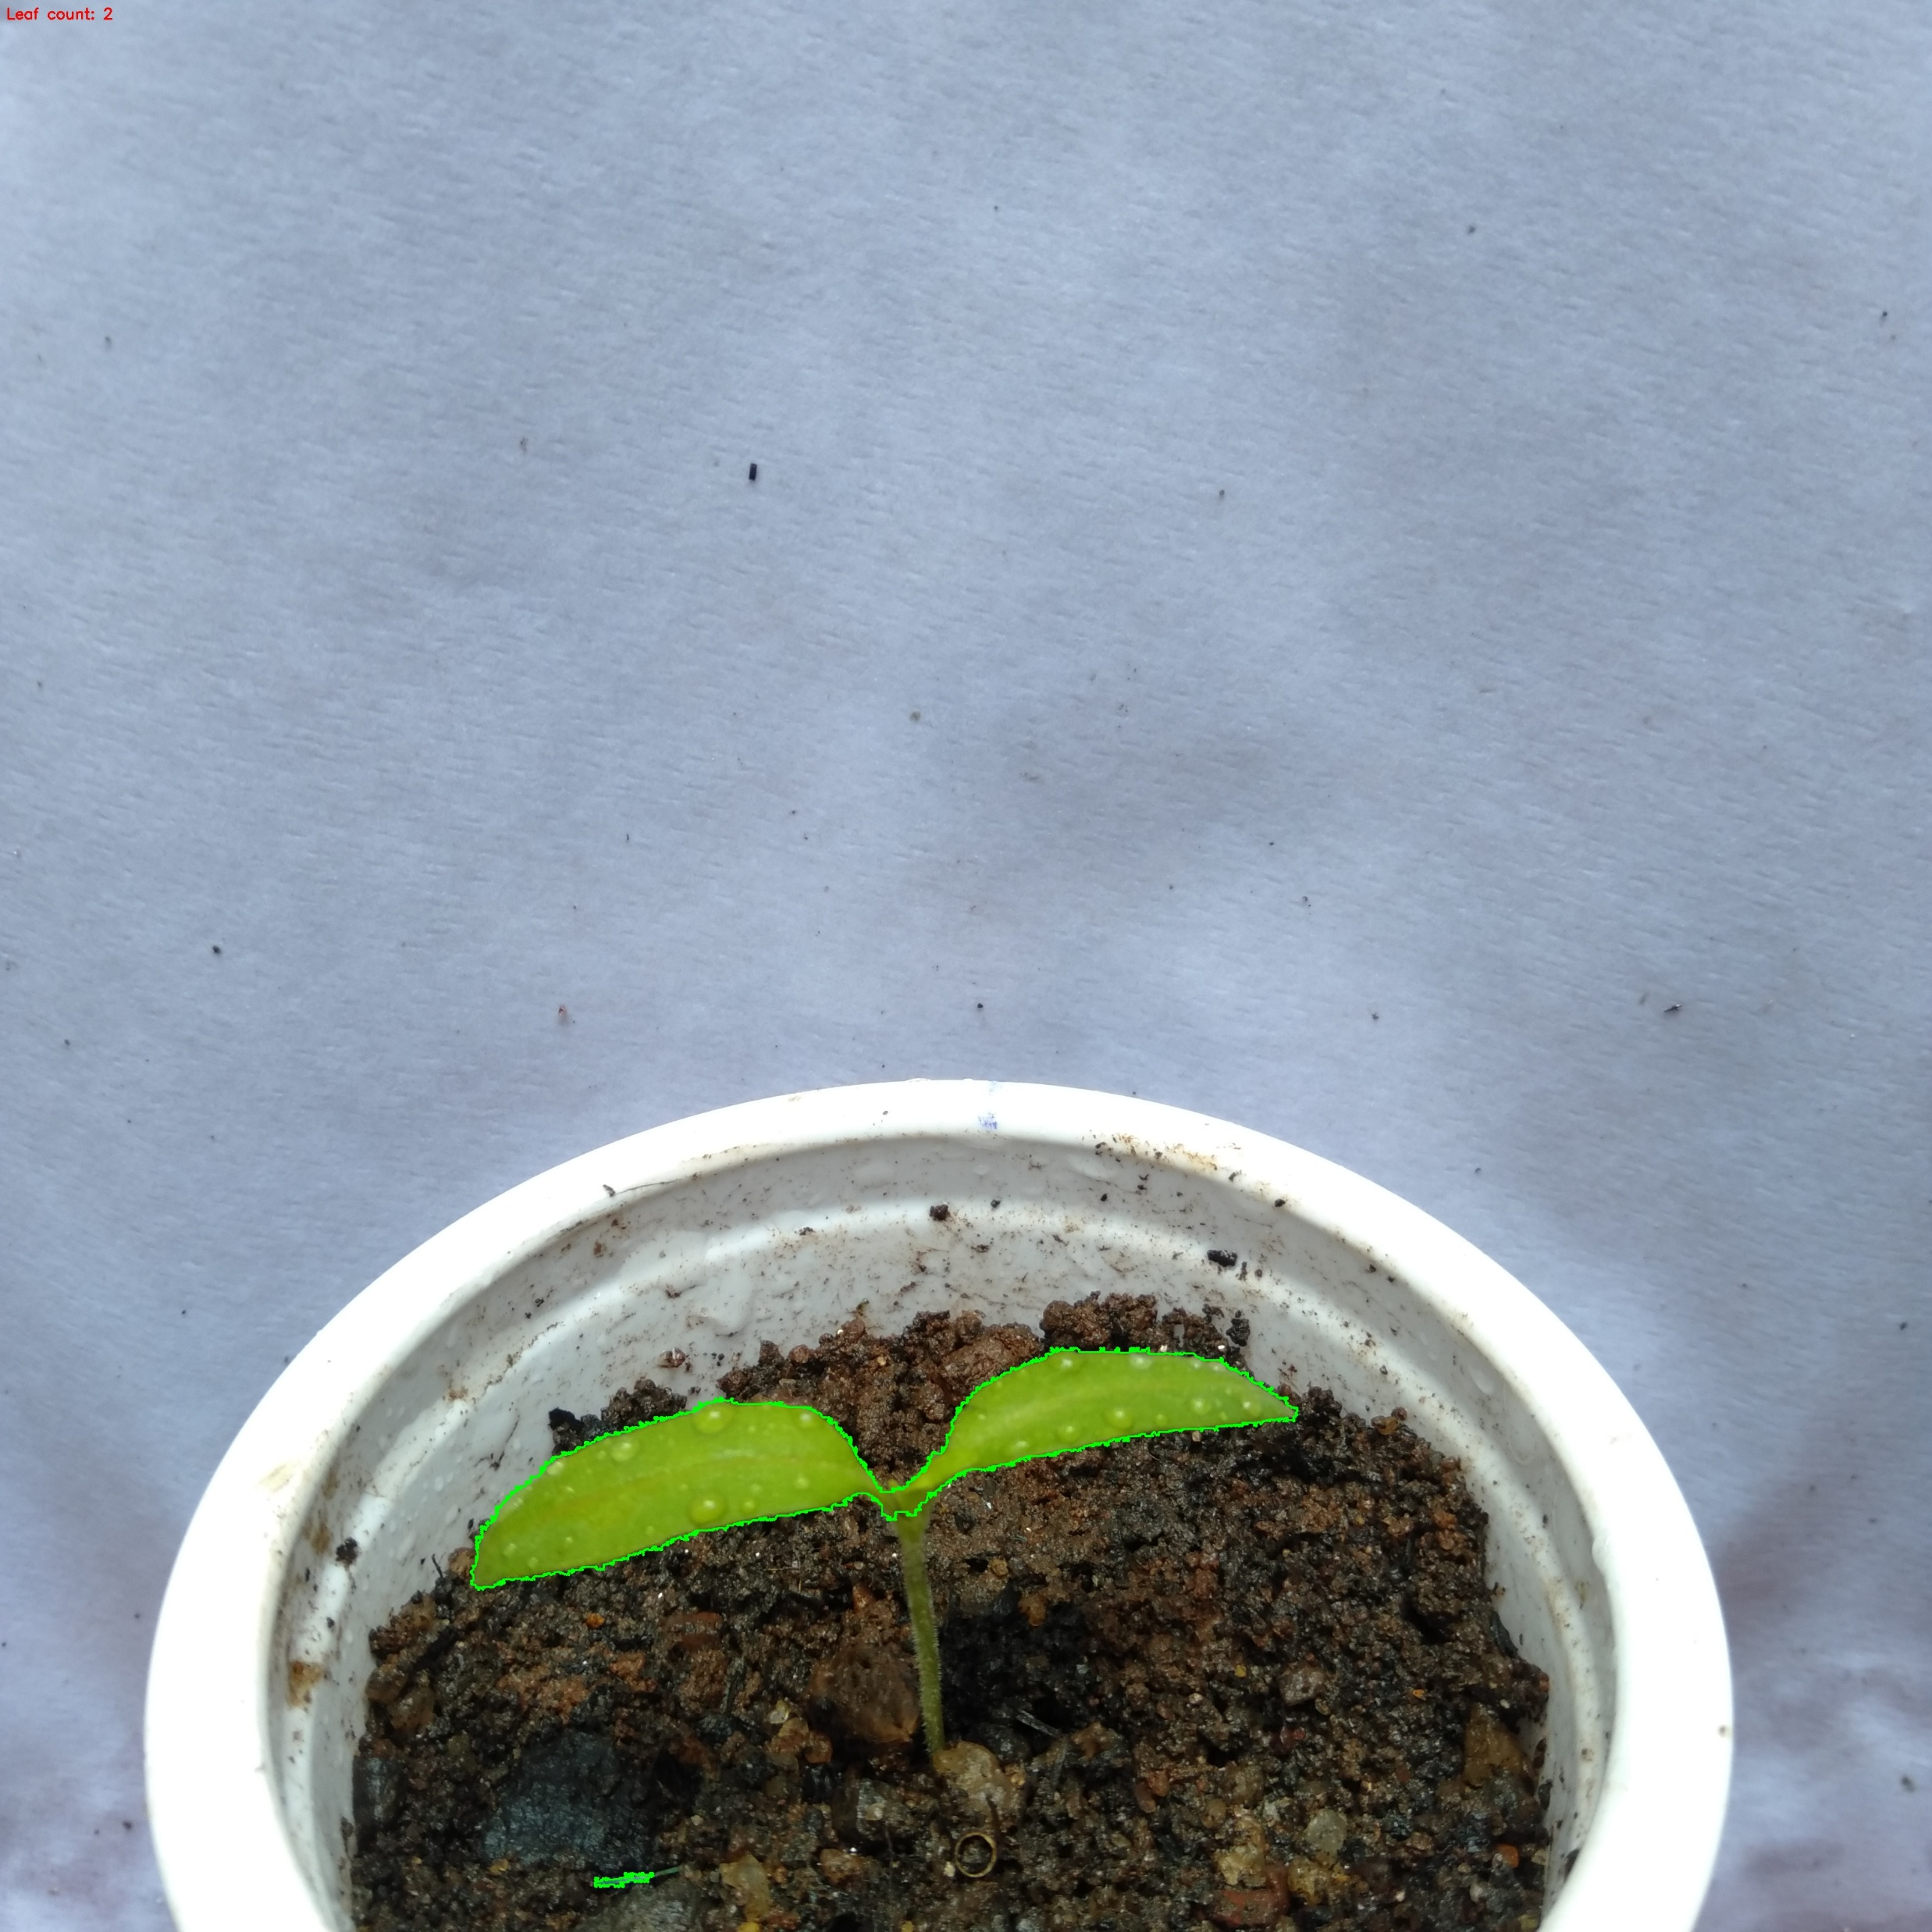

Day 1 – Processing Steps
Leaves : 2
Leaf Area : 0.48cm
Leaf Color (Average):
Original Image
HSV color segmentation
Final contour detection with leaf count and area
After morphological operations

Slide 7
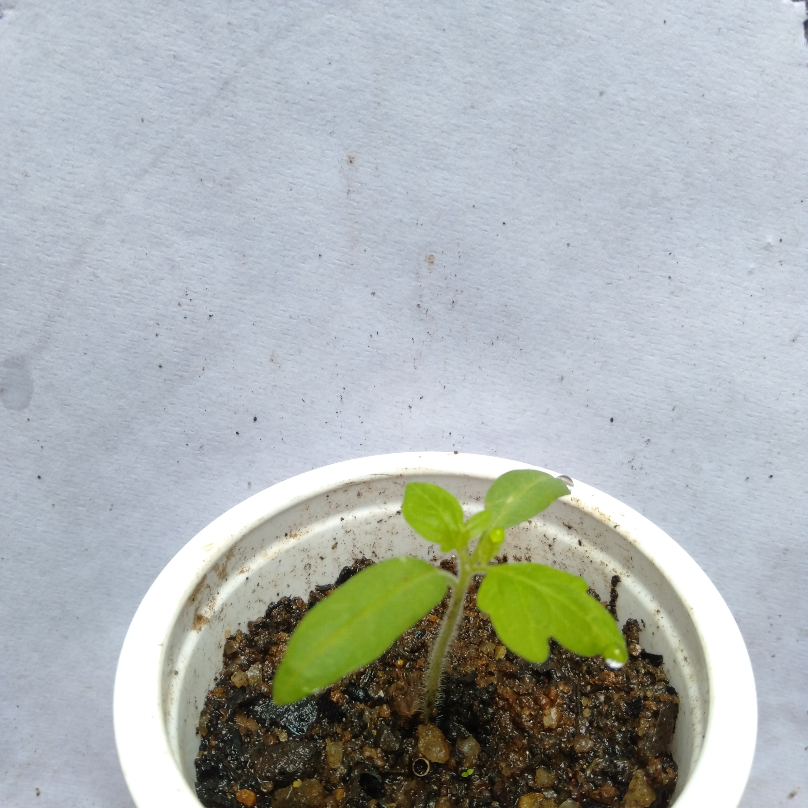
Day 6 - Original Image

Slide 8
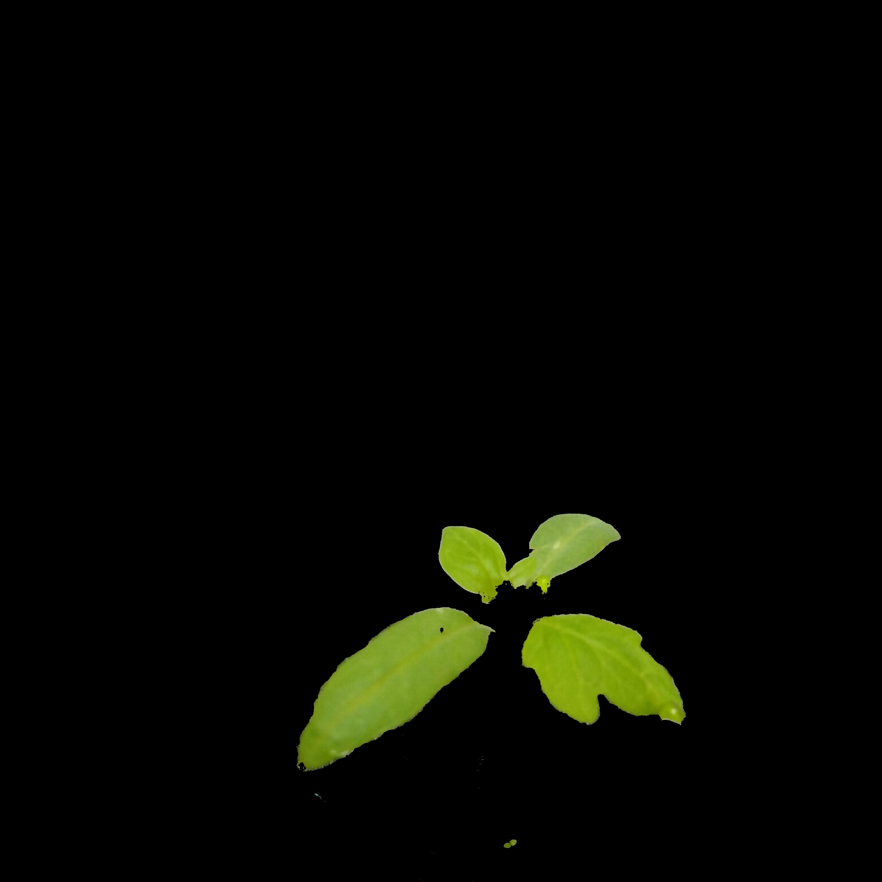
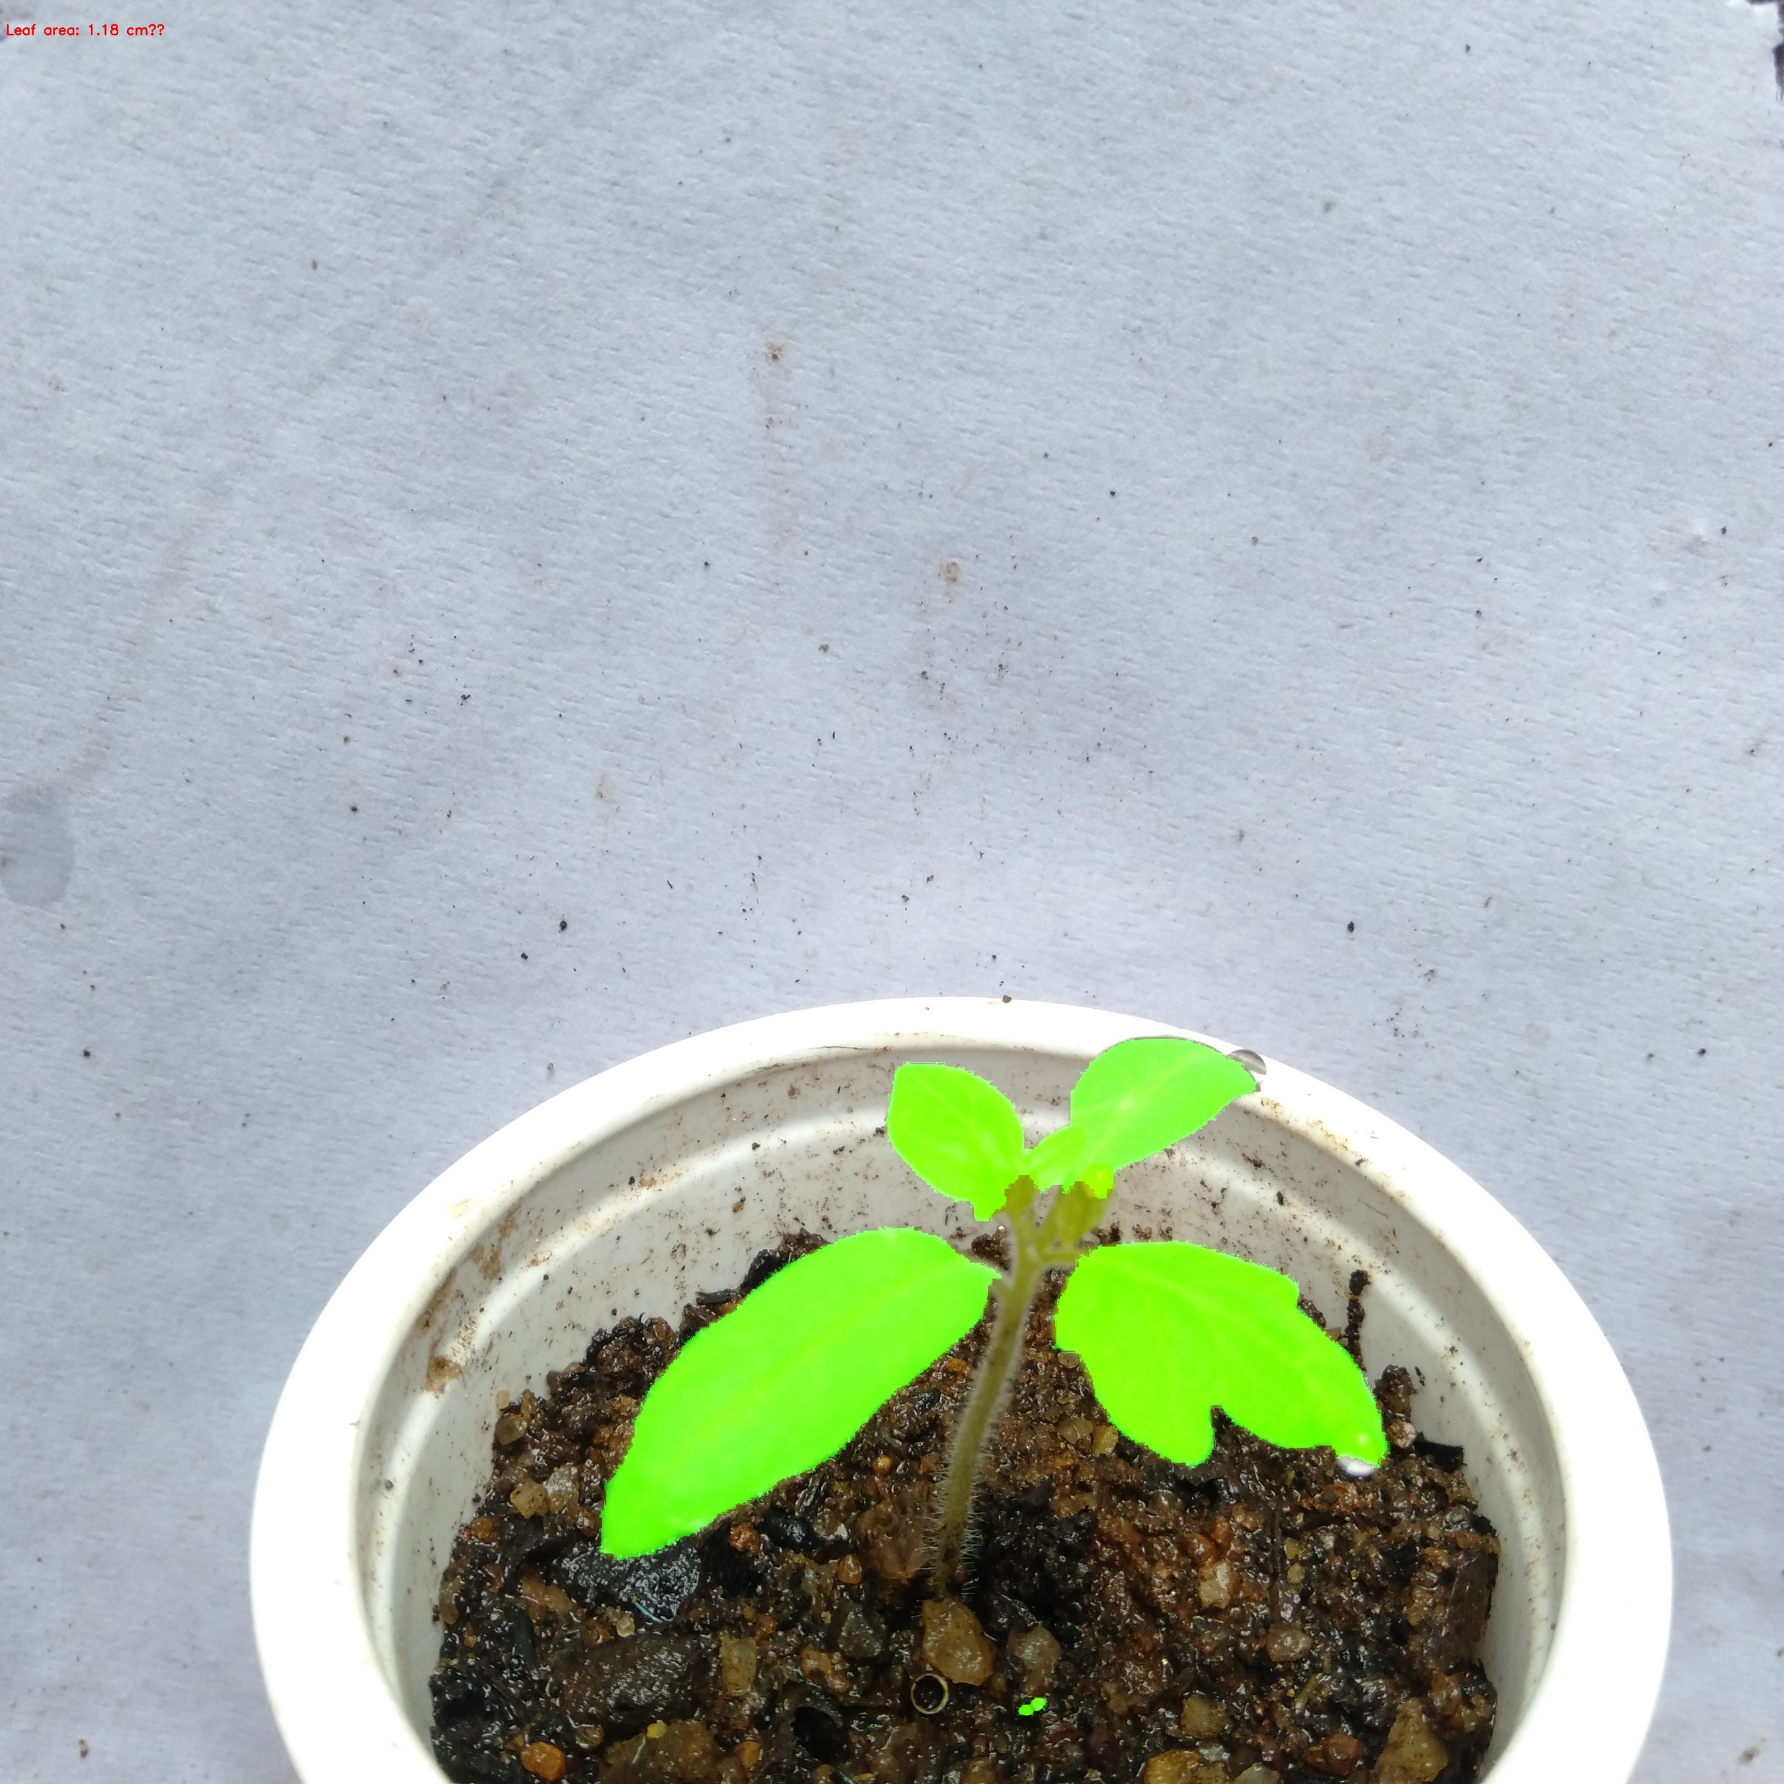


Day 6 – Processing Steps
Leaves : 4
Leaf Area : 1.18cm
Leaf Color (Average):
Original Image
HSV color segmentation
Final contour detection with leaf count and area
After morphological operations

Slide 9
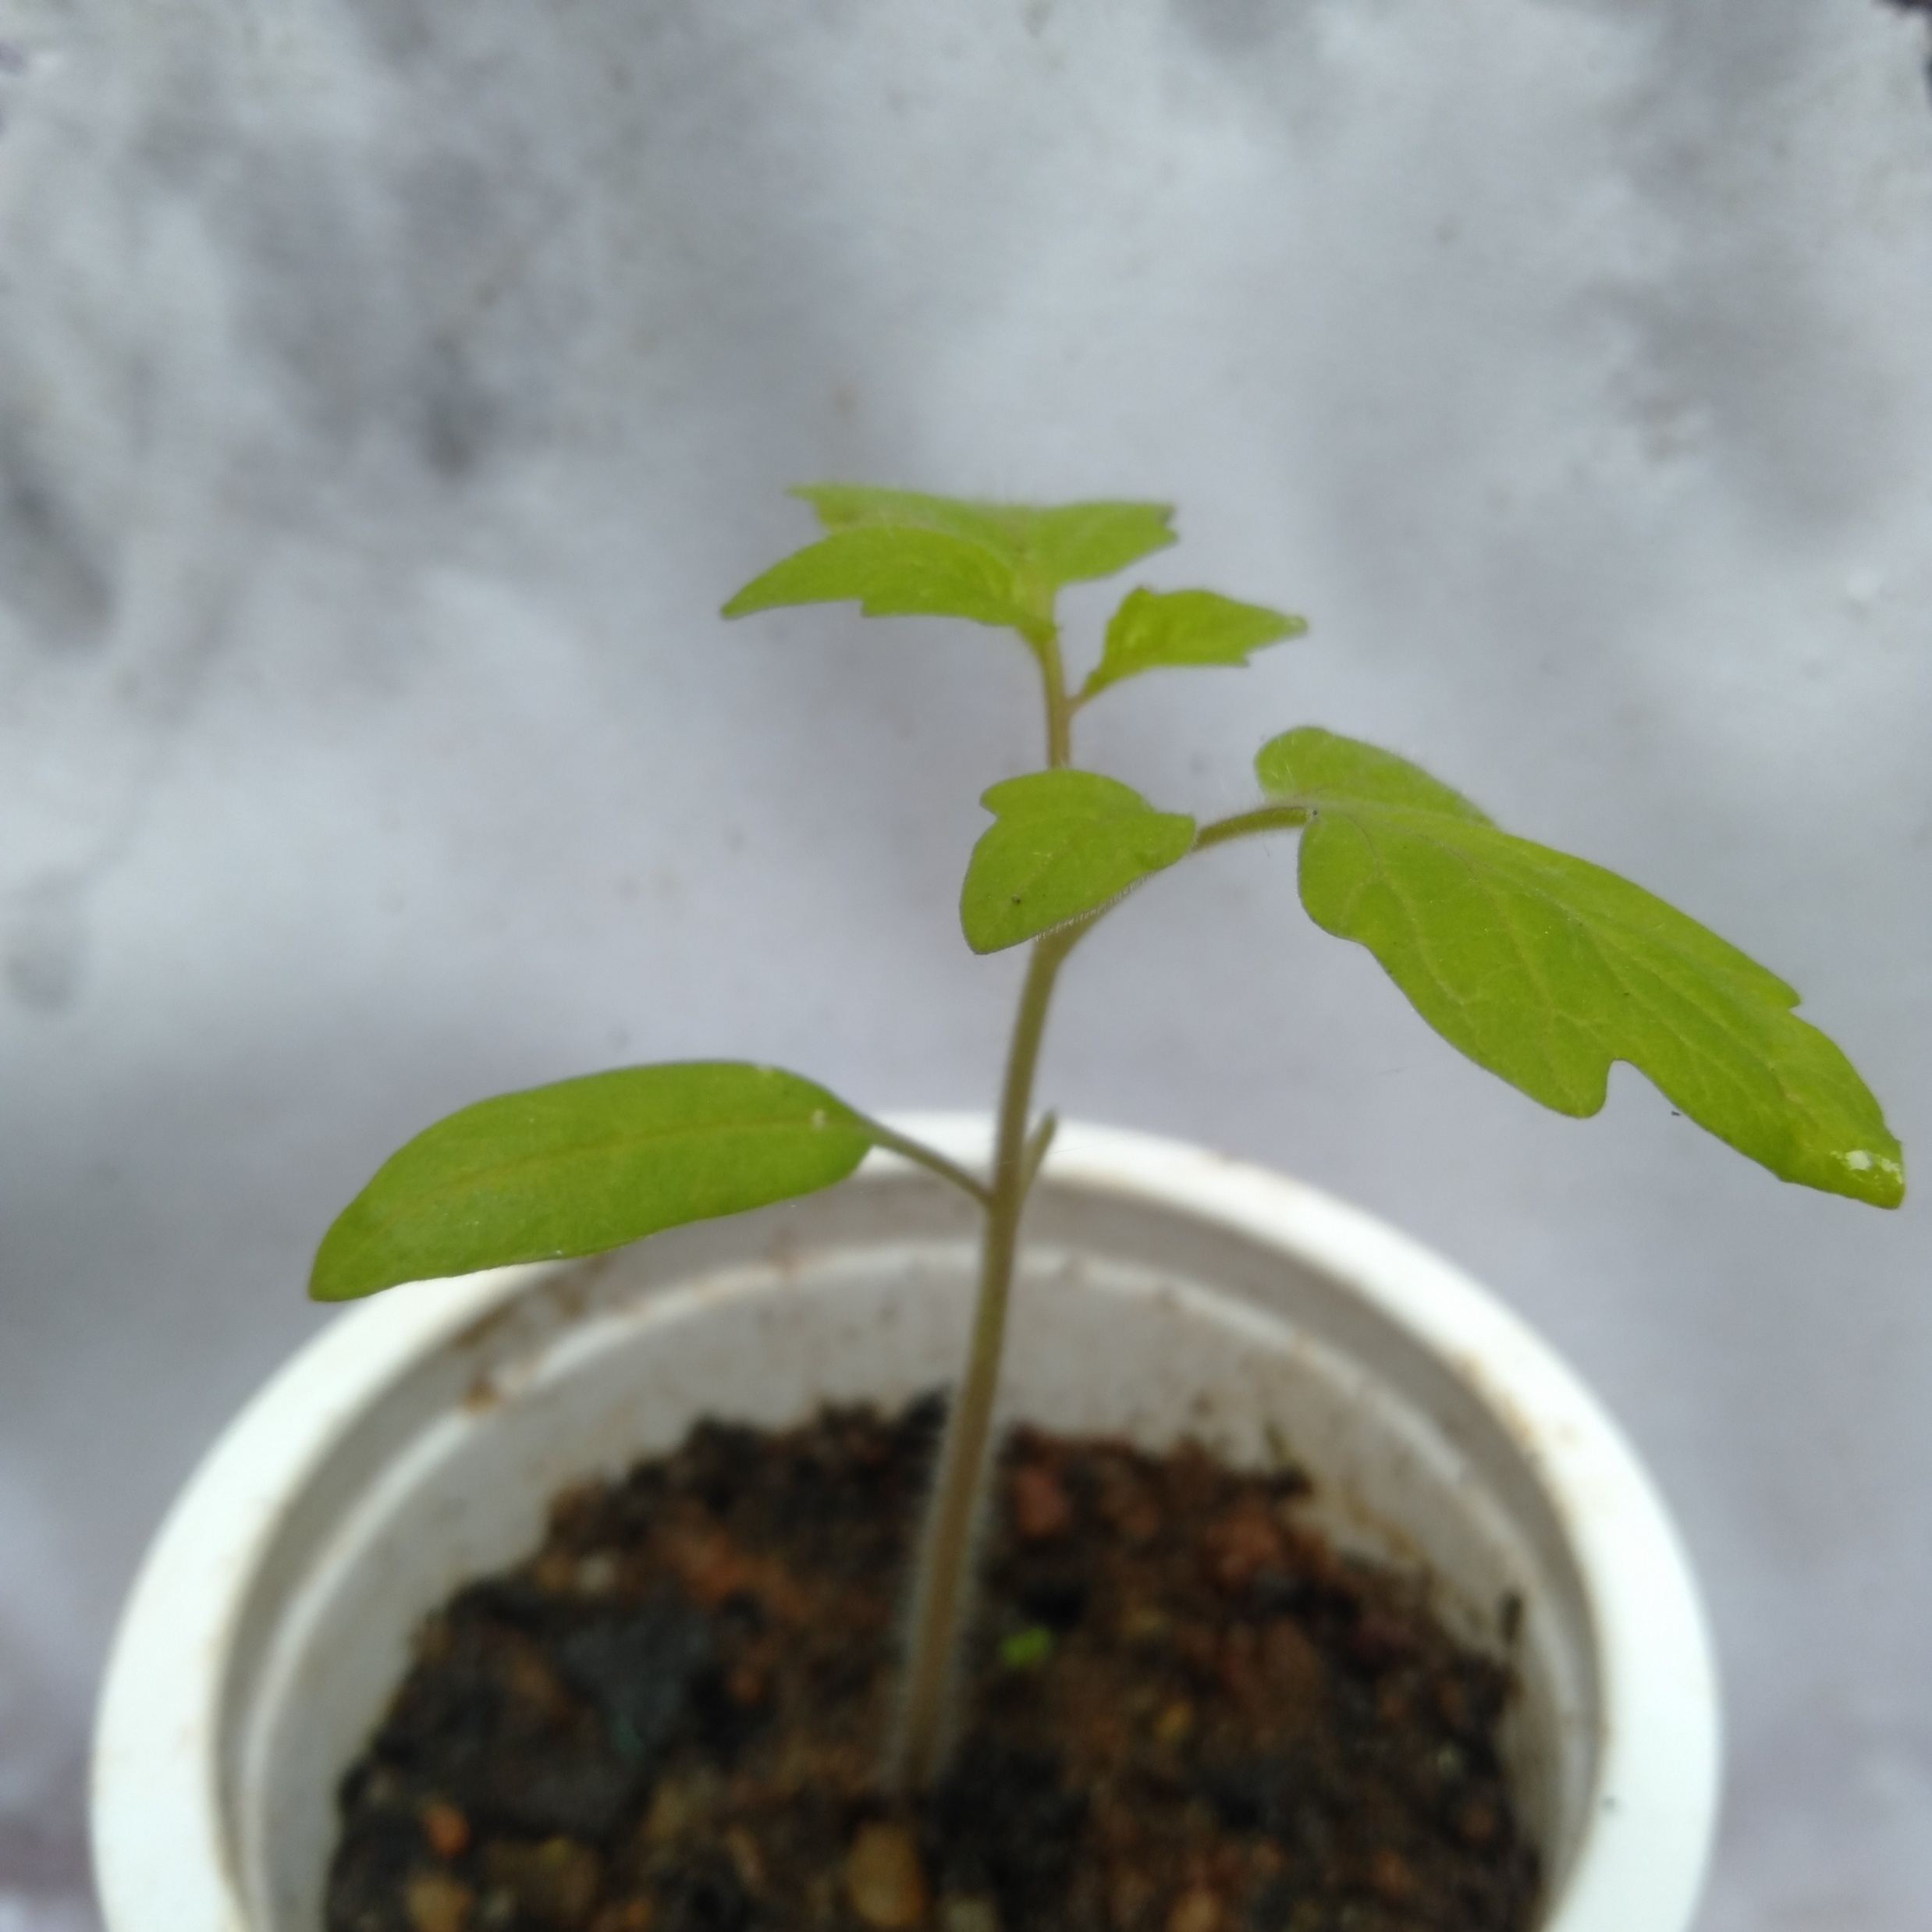
Day 12 - Original Image

Slide 10
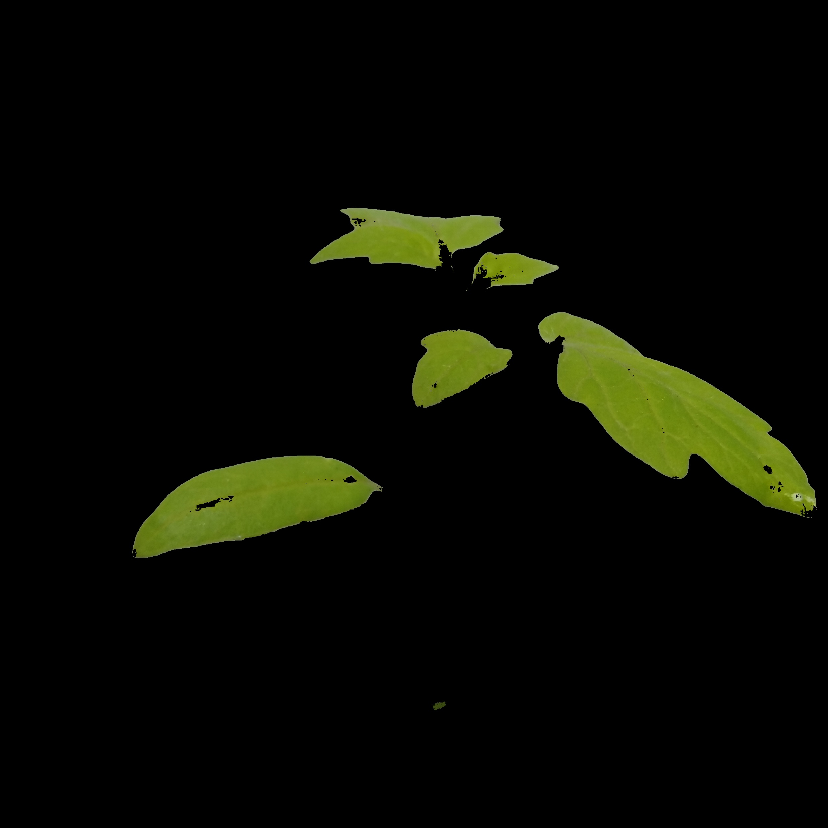
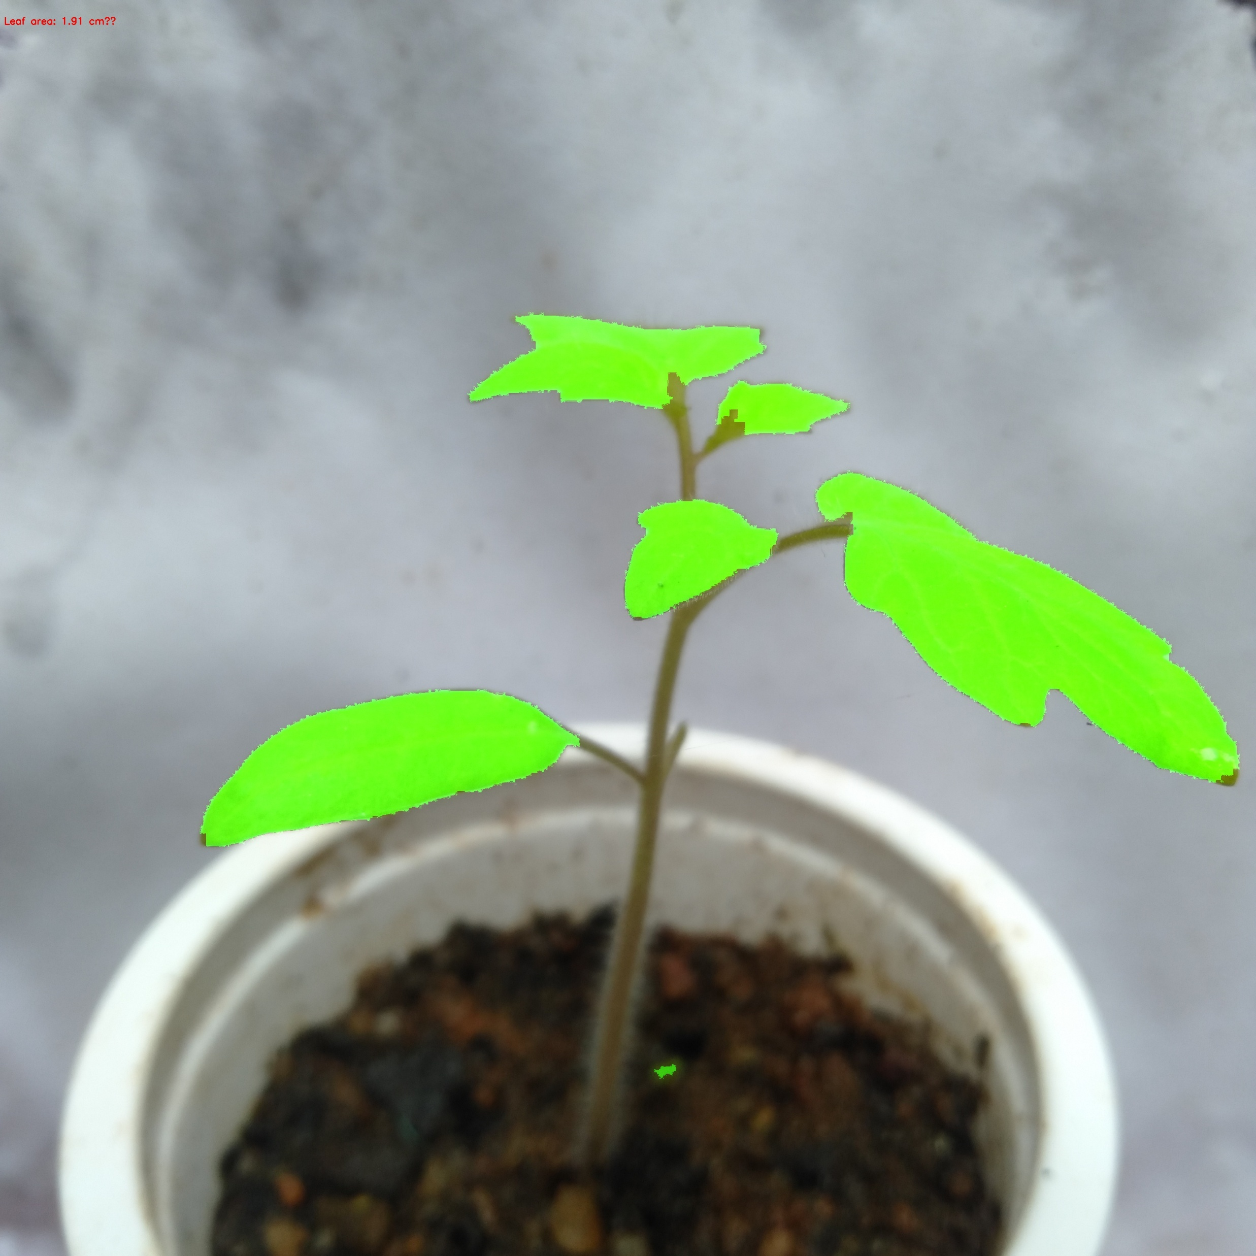
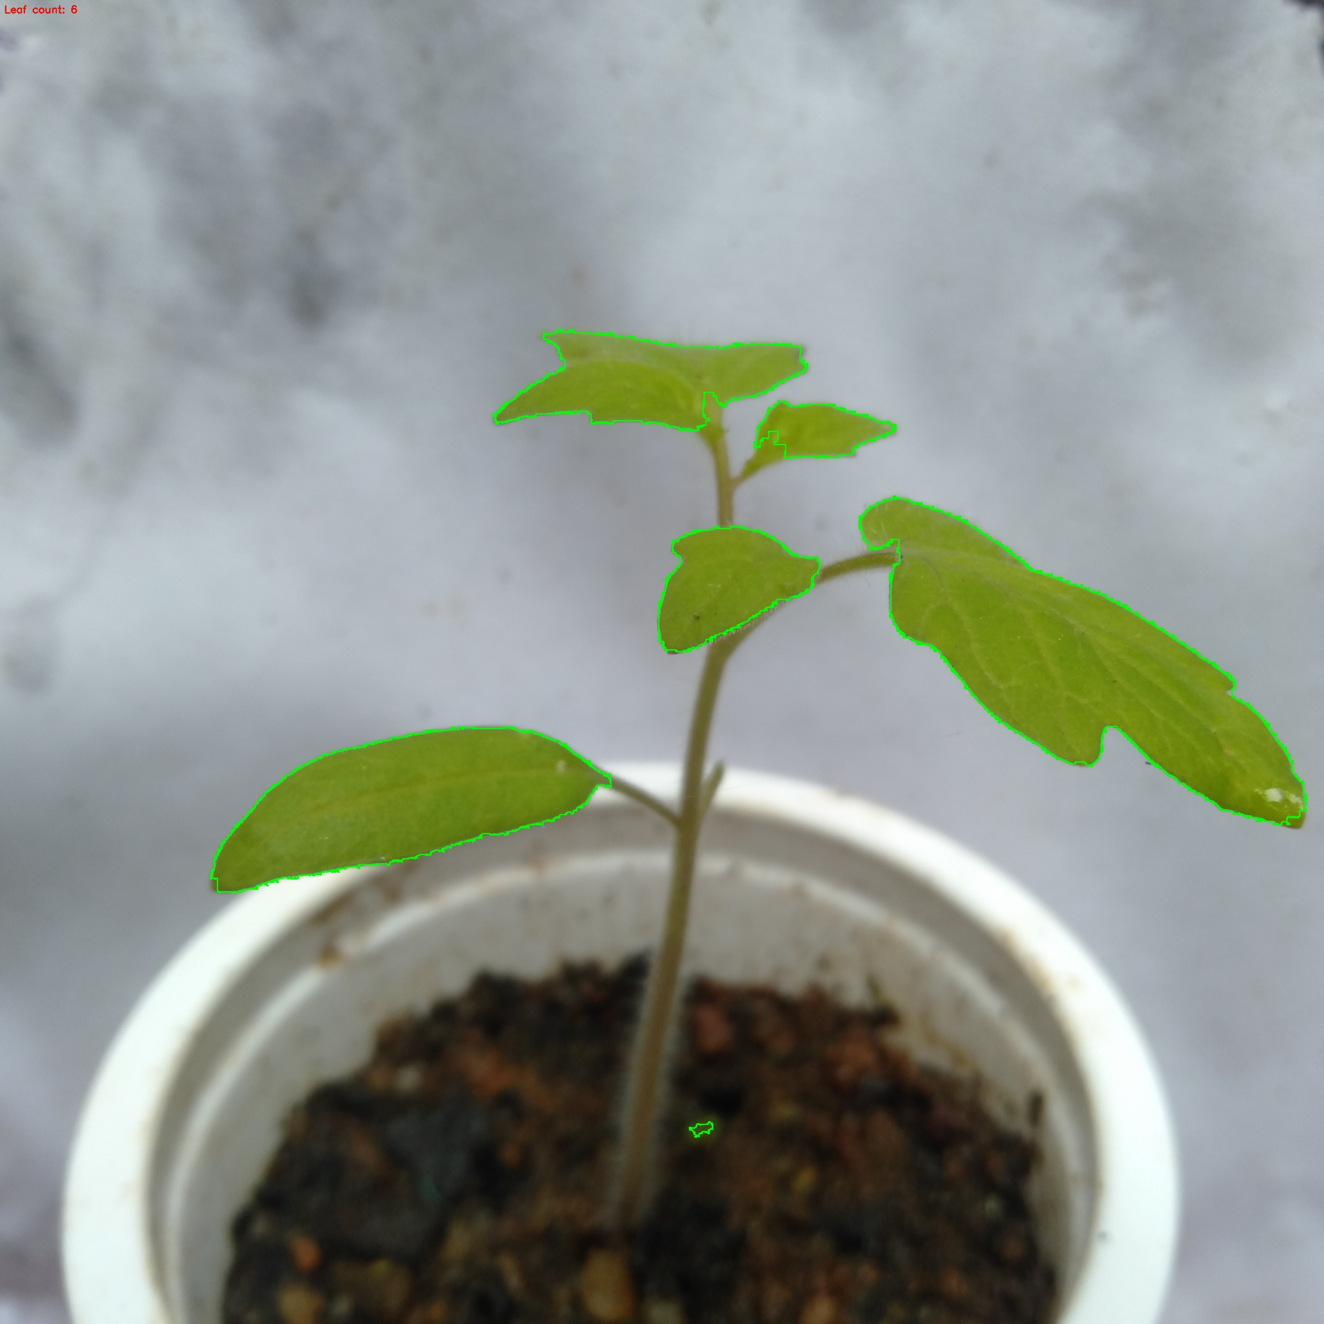

Day 12 – Processing Steps
Leaves : 6
Leaf Area : 1.91cm
Leaf Color (Average):
Original Image
HSV color segmentation
Final contour detection with leaf count and area
After morphological operations

Slide 11
Quantitative Results (Day 1, 6 & 12)
Day | Leaves Count | Leaf Area | Leaf Color (RGB)
Day 1 | 2 | 0.48 cm | (123,159,27)
Day 6 | 4 | 1.18 cm | (119,147,27)
Day 12 | 6 | 1.91 cm | (115,138,30)

Slide 12
CHALLENGES & SOLUTIONS
Challenge | Solution
Background noise | Clean and white background
Segmentation errors | Tuned thresholds(mask)
CONCLUSION
Successful image-based monitoring of tomato plant growth.
System allows measurement of leave count, leave area, leave color(RGB).

Slide 13
Thank You
References: Open CV documentation & google

